Slide 1
Functional Approach in Self-Timed Circuit Design
Plekhanov Leonid, Zakharov Victor, Stepchenkov Yuri
Institute of Informatics Problems, Federal Research Center "Computer Science and Control" of the Russian Academy of Sciences, IPI RAS, Moscow, Russian Federation
IPI RAS EWDTS-2015 1

Slide 2
Contents
Event-driven analysis of SI-circuits
Functional analysis of SI-circuits:
Low level analysis
High level analysis
Synthesis of SI-circuits
Conclusions
IPI RAS EWDTS-2015 2

Slide 3
Essence of event-driven analysis
Analyzed circuit should be presented in a closed feed-back form: only outputs and feed-backs
Analyzed circuit
Feed-back
IPI RAS EWDTS-2015 3

Slide 4
Problems of event-driven analysis
Analysis is carried out only for one initial state – completeness is far of practical needs
Exponential dependence of the computational complexity on the number of elements and degree of parallelism
IPI RAS EWDTS-2015 4

Slide 5
Event-driven analysis: Change Diagrams, part 1
Circuit | Micro-pipeline control queue |  | Asynchronous switch
CAD Tool | Time, sec | Memory / disk swaping | Time, sec | Memory
TRANAL | 180 | 400 Kbytes /+ | 0.28 | 100 Kbytes
VERDECT | 300 | 22 Mbytes /– | 0.99 | 122 Kbytes
TRASPEC | 1 | 100 Kbytes /– | 0.38 | 100 Kbytes
IPI RAS EWDTS-2015 5

Slide 6
Event-driven analysis: Change Diagrams, part 2
CAD tools | Paral-lelism | Circuit level | Memory for state, Gbyte | Number of states per hour, 10⁶
TRANAL | 5-6 | cells | 0.64 | 0.3
BTRAN | 12-16 | modules | 2 | 1.0
ASYAN | 18 -24 | blocks | 48 | 200
IPI RAS EWDTS-2015 6

Slide 7
Event-driven analysis: software tools from IPI RAS
Unit's type – capacity / parallelism | Analysis time, min^{*)}
 | BTRAN | ASYAN | ASPECT
Binary counter – 4 / 1 | 0.01 | 0.12 | 0.02
Shift register – 4 / 4 | 0.21 | 0.97 | 0.02
Microcore – 4 / 47 | − | 0.53 | 0.02
ALU – 64 / 293 | − | − | 0.14
Divider – 16 / 330 | − | − | 1588
Divider – 64 / 1024 | − | − | 27360
^{*)} for single state of inputs and triggers
IPI RAS EWDTS-2015 7

Slide 8
Functional approach
Analyzes the equations of circuits
Deals with the open circuits
Takes into account a nature of speed-independent circuits:
ST-coding of data
Two-phase operation discipline (work phase and spacer one)
Signal indication, and so on
IPI RAS EWDTS-2015 8

Slide 9
Functional approach: SI circuit definition
An open circuit possessing two features:
Absence of races for any finite delay of the elements
Indicativeness of all inputs, outputs and internal signals
IPI RAS EWDTS-2015 9

Slide 10
Functional approach: hierarchical analysis
Top level
High levels: structural description
…
Block 1
Block N
…
Lower level: logical function description
Unit 1
Unit 2
Unit M
IPI RAS EWDTS-2015 10

Slide 11
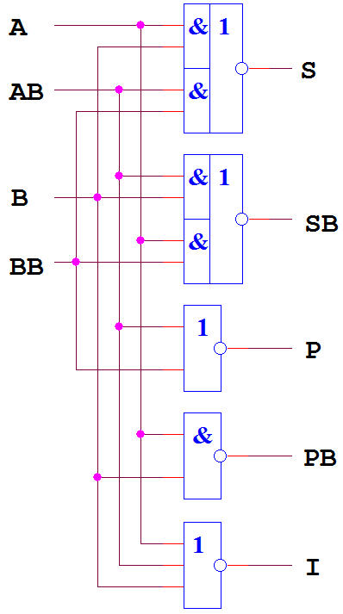
Low level analysis
IPI RAS EWDTS-2015 11

Slide 12
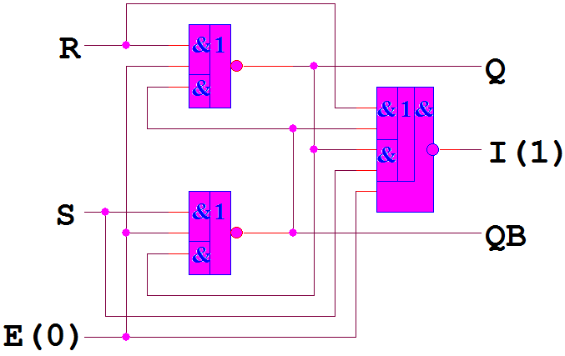
Low level analysis: races control
IPI RAS EWDTS-2015 12

Slide 13
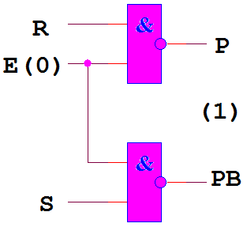
Low level analysis: races control
IPI RAS EWDTS-2015 13

Slide 14
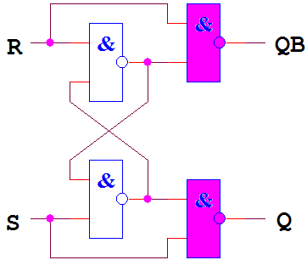
Low level analysis: races control
IPI RAS EWDTS-2015 14

Slide 15
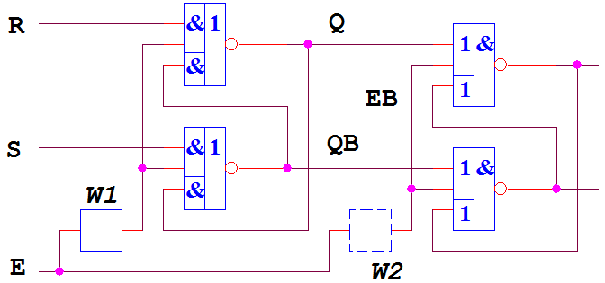
Low level analysis: connection control
IPI RAS EWDTS-2015 15

Slide 16
High level analysis: checking lists & attributes
Hierarhical approach on base of verified low level units
Verifying connections
Verifying indicativeness
Verifying absence of races
Preparing descriptions for next analysis level
IPI RAS EWDTS-2015 16

Slide 17
Functional analysis via Event-driven analysis
Unit's type – capacity / parallelism | Analysis time, min
 | ASPECT^{*)} | FAZAN
Microcore – 4 / 47 | 0.02 | 0.01
^{*)} for single state of inputs and triggers
IPI RAS EWDTS-2015 17

Slide 18
Synthesis of SI circuits
Based on logical functions that are not self-timed
Balanced by performance and complexity
Minimized indication circuit
Software tools
IPI RAS EWDTS-2015 18

Slide 19
Synthesis of SI circuits
F1 = A ∧ B, F2 = B ∧ C
V1 = A ∧ B, V2 = B ∧ C,
VB1 = AB ∨ BB, VB2 = BB ∨ CB,
indications
I1 = A ∨ AB, I2 = B ∨ C ∨ BB ∧ CB
IPI RAS EWDTS-2015 19

Slide 20
Conclusions
The functional approach provides the following advantages:
Analysis of SI-feature of open circuits
Hierarchical SI-analysis of VLSI and SoC
Synthesis of combinational circuits with dual-rail signals by given criterion of performance or complexity
IPI RAS EWDTS-2015 20

Slide 21
Thanks!
IPI RAS EWDTS-2015 21

Slide 22
Contacts
Director: academician Sokolov I.A.
Address: Institute of Informatics Problems of the Federal Research Center "Computer Science and Control" of the Russian Academy of Sciences (IPI RAS), Moscow, Russian Federation, 119333, Vavilova str., 44, b.2
Tel: +7 (495) 137 34 94
Fax: +7 (495) 930 45 05
E-mail: ISokolov@ipiran.ru
Stepchenkov Y.A., tel. +7 (495) 671 15 20, Ystepchenkov@ipiran.ru
IPI RAS EWDTS-2015 22

