Slide 1
Self-assembly phenomenon implementation problems in recurrent-dynamic architecture
Dmitry V. Khilko, Yury A. Stepchenkov , Georgy A. Orlov, Yury I. Shikunov
Institute of Informatics Problems, Federal Research Center "Computer Science and Control" of the Russian Academy of Sciences, Russia, Moscow.
ElConRus2023 January 24 - 27, 2023, St. Petersburg, Russia

Slide 2
Recurrent-Dynamic Approach
Main principles of recurrent-dynamic approach (RDA):
Self-assembly phenomenon
via data-flow model of computation and recurrency
Self-sufficient data element (ESD)
via combination of separate data and instruction flows into one self-sufficient flow
Recurrency
via encoding (recurrent convolution) of data-flow graph fragments into self-sufficient data
and decoding (recurrent involution) of self-sufficient data during computational process

Slide 3
Multi-core Recurrent Data-flow Architecture
New data-flow processor designed for select use cases.
Primary goal: DSP
Objectives:
Logic Step improvements
via self-sustained data
Low memory footprint
via recurrency requiring no extra memory (stack) through operand compression

Slide 4
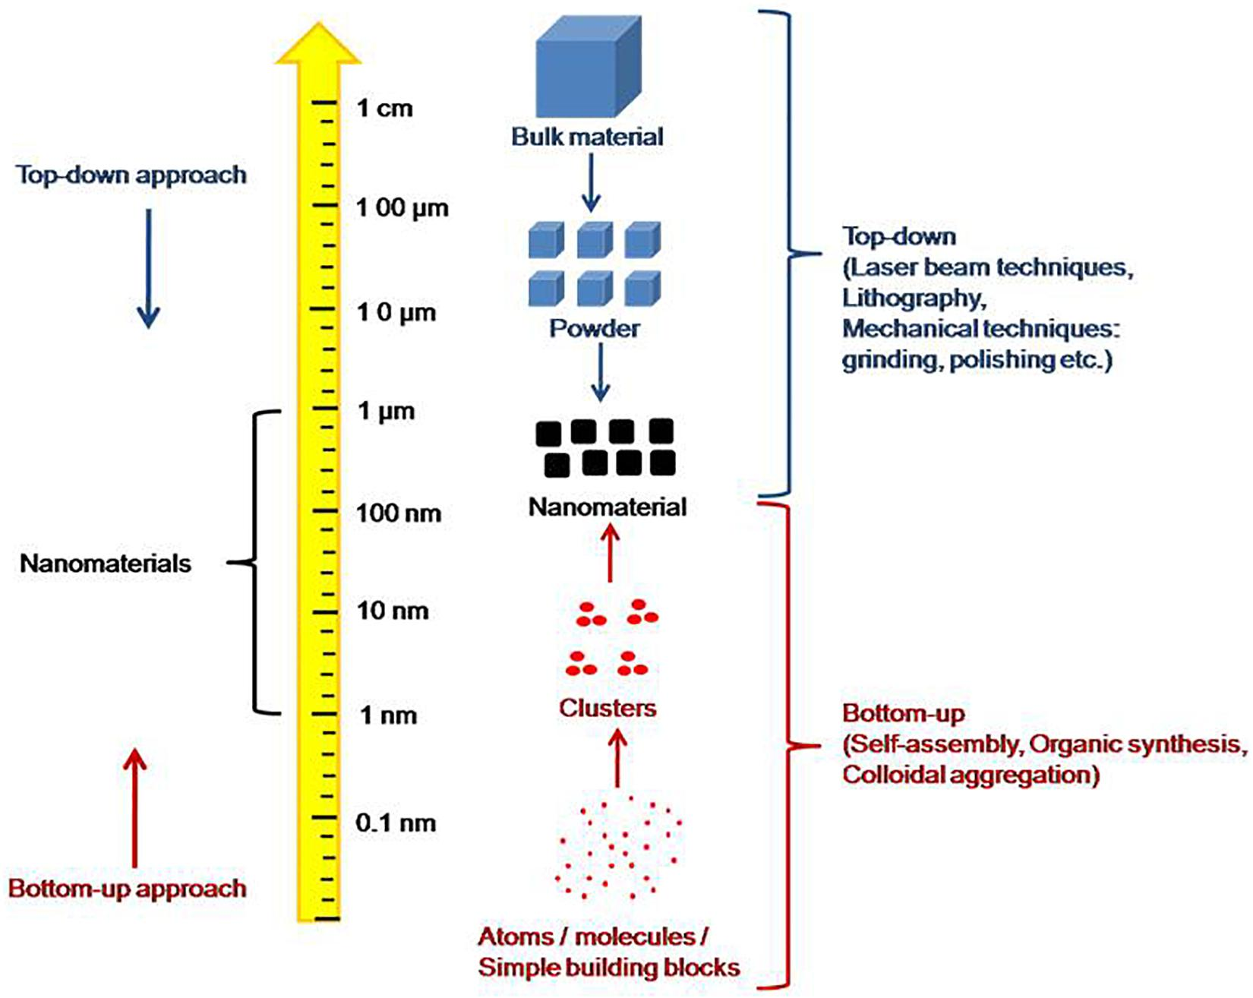
Self-assembly phenomenon strategies
Existing self-assembly strategies are*:
Top-down
not requires atomic control
Bottom-up
requires atomic control to form well-organized structures
Within Recurrent-dynamic approach Bottom-up strategy has been chosen.
* S. Yadav, A. K. Sharma, P. Kumar. Nanoscale Self-Assembly for Therapeutic Delivery Frontiers in Bioengineering and Biotechnology. 2020.

Slide 5
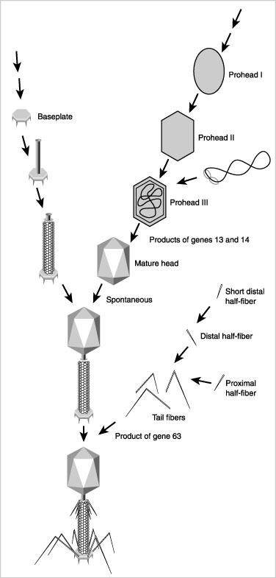
Self-assembly scenario of bacteriophage T4
Biological process of virus construction as the bottom-up self-assembly strategy example.

Slide 6
Self-sufficient data-flow features
Sequence of ESD that encapsulates a solution for specified task is called “capsule”.
Capsule is a main programming element within RDA

Slide 7
Recurrency implementation theory
Main principle – functional operator application on algebraic space of binary numbers.
Consequent application of these operators generates different topologies of transformation chains.
We call it “recurrent chains”.

Slide 8
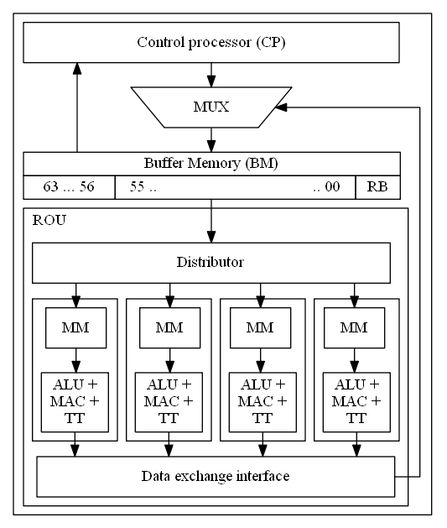
Recurrent data-flow architecture prototype
The architecture prototype is implemented as two-level “Hybrid Architecture of a Recurrent Signal Processor” (HARSP)
Recurrency is implemented with universal Tag Transform (TT) unit with code redundancy.

Slide 9
Universal Tag Transformer graph
Universal TT generates tree-like graph structure that converges to the zero self-returning pole (zero vertex).

Slide 10
Self-assembly implementation problems
Problems:
Short length of recurrent chains
The TT unit is located at the last pipeline stage
There is no mechanism to merge capsules
Possible solutions:
Develop a family of TT unit, that includes universal and a set of specialized
Provide customization and configuration tools for TT units
Place universal TT at last pipeline stage and specialized TT units at initial stages to fill pipeline more densely
Develop mechanism that enables direct write-access from one capsule to another
Rise capsule status to a macro-recurrent chain

Slide 11
Conclusion
Solving these problems will allow us to:
improve the versatility of RDA;
improve the performance of architecture based on RDA;
increase the compression degree of the capsules;
simplify the programming process.

Slide 12
Thank you for your attention!
Speaker: Dmitry Khilko Email: dhilko@yandex.ru

