Slide 1
Cell Library for Speed-Independent VLSI
Stepchenkov Yuri, Zakharov Victor, Rogdestvenski Yuri, Diachenko Yuri, Morozov Nickolai, Stepchenkov Dmitri
Institute of Informatics Problems, Federal Research Center "Computer Science and Control" of the Russian Academy of Sciences, IPI RAS, Moscow, Russian Federation
IPI RAS EWDTS-2015 1

Slide 2
Contents
Main features of SI-circuits
Content of the cell library
Interface cells
Cells with forced outputs
Indication cells
Characterization and approbation
Conclusions
IPI RAS EWDTS-2015 2

Slide 3
Main features of SI-circuits
Speed-Independent (SI) circuits excel synchronous ones in:
Robustness to variation of electrophysical parameters or to their degradation
Operation safety and validity of the data processing results
High performance, that is maximum possible at any real environment and data
IPI RAS EWDTS-2015 3

Slide 4
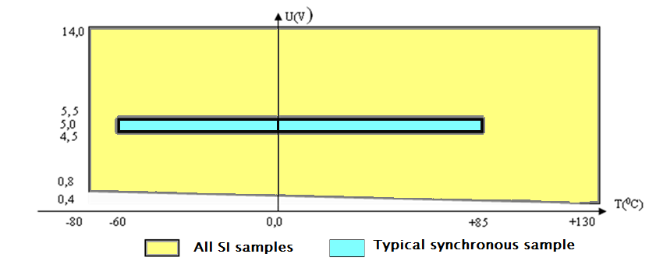
Experience in SI-circuits
4-Bit Microcontroller core (analog of PIC18)
Complexity is greater by factor of 1.43,
Workability range (S=ΔU*ΔT) is wider by factor of 16,
Performance is higher by factor of 3.25
IPI RAS EWDTS-2015 4

Slide 5
Peculiarities of SI-circuits
Two-phase discipline: work and spacer (pause)
Indication of each operation phase
Acknowledge-require technique of interaction between SI-units
An arbitrary duration of each phase
IPI RAS EWDTS-2015 5

Slide 6
Specific circuit base for SI-units
All cells for designing SI-circuits must be single-stage one or have an output indicating all interior signals
Their inputs and outputs take only logical 0 and 1 values
IPI RAS EWDTS-2015 6

Slide 7
Library’s content
Combinational logic
Triggers
Counters
Multiplexers
Adders
Code converters
Indicators
IPI RAS EWDTS-2015 7

Slide 8
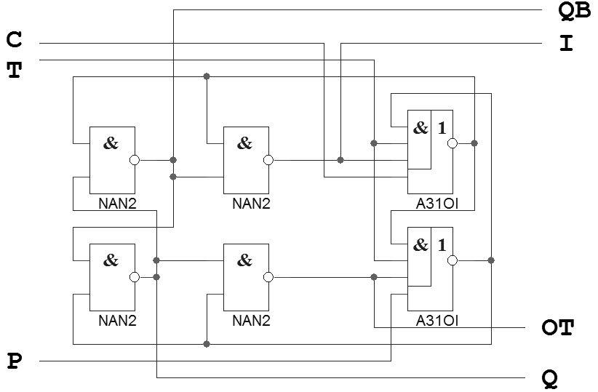
Bit of binary counter
T, TO – complementing input and output; C, P – preset inputs; I – indicator
IPI RAS EWDTS-2015 8

Slide 9
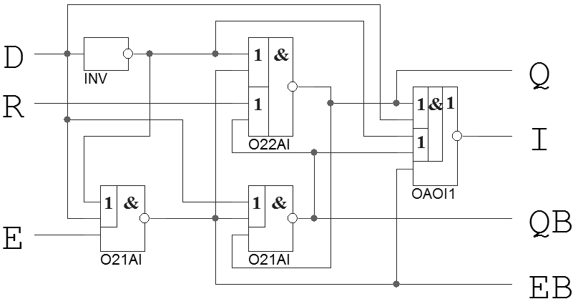
Interface cells: latch
D – unary data input; E – write enable input with null spacer; R – asynchronous reset
IPI RAS EWDTS-2015 9

Slide 10
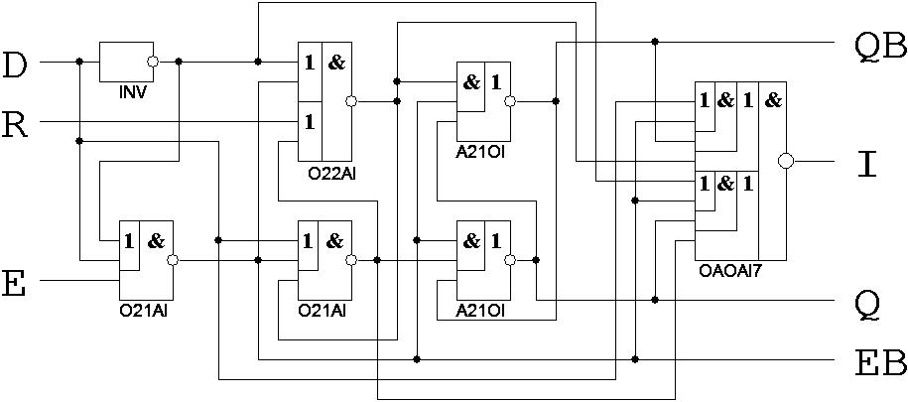
Interface cells: flip-flop
D – unary data input; E – write enable input with null spacer; R – asynchronous reset
IPI RAS EWDTS-2015 10

Slide 11
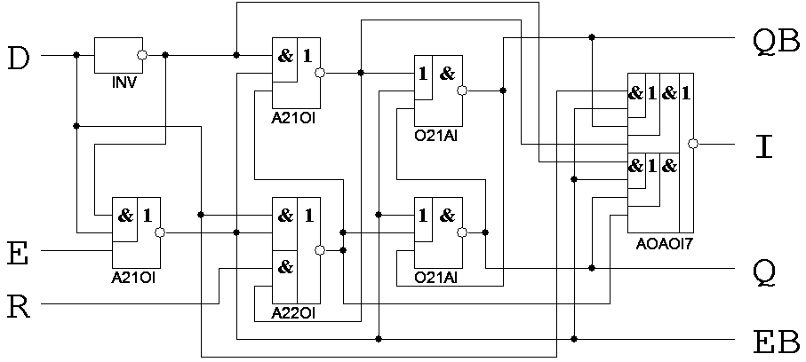
Interface cells: flip-flop
D – unary data input; E – write enable input with unit spacer; R – asynchronous reset
IPI RAS EWDTS-2015 11

Slide 12
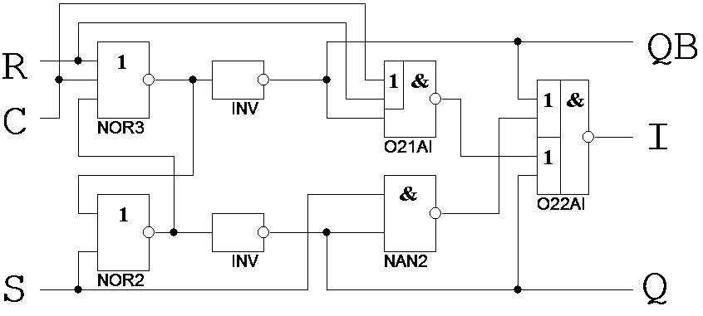
Cells with forced output: latch
R, S – dual-rail data input; C – self-timed reset; Q, QB – bi-phase forced output
IPI RAS EWDTS-2015 12

Slide 13
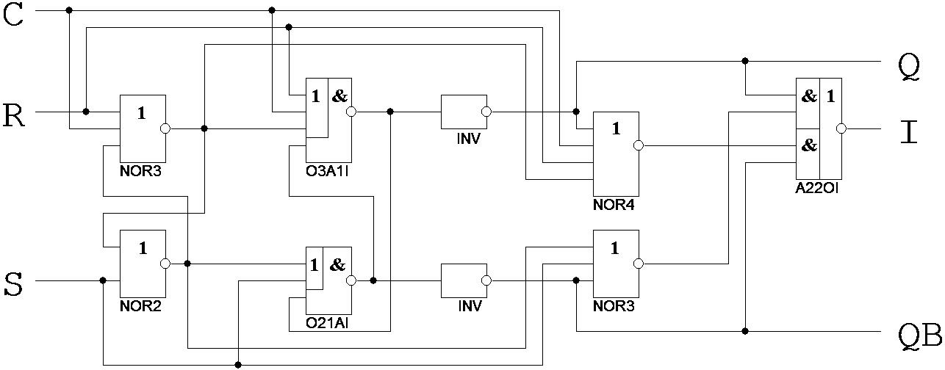
Cells with forced output: flip-flop
R, S – dual-rail data input; C – self-timed reset; Q, QB – forced output
IPI RAS EWDTS-2015 13

Slide 14
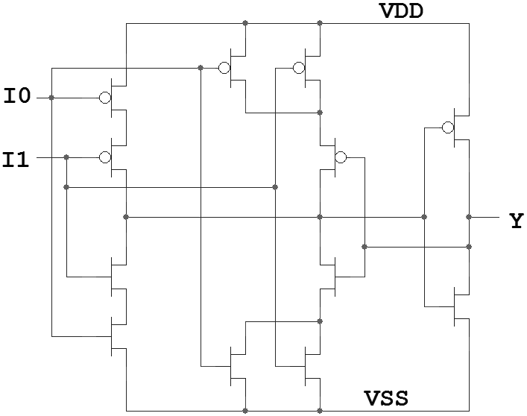
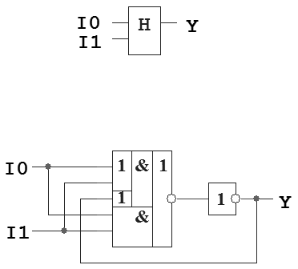
Indication cells: hysteresis triggers
I0, I1 – indication signals
IPI RAS EWDTS-2015 14

Slide 15
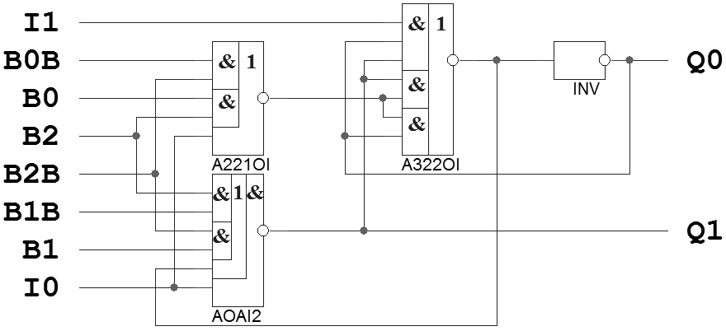
Indication cells: combined logic
I0, I1 – indication signals;
B*,B*B – bi-phase data signals
IPI RAS EWDTS-2015 15

Slide 16
Library characterization
Self-timed feature analysis (ASPECT)
Automatic calculation of the electrical and timing parameters (STERH)
Model files in LIBERTY and Verilog formats (STERH)
Integration with modern industrial CADs
IPI RAS EWDTS-2015 16

Slide 17
Cell library approbation
Various CMOS standard processes:
1.5 μm for semicustom circuits (Microcore, 14 000 transistors),
0.18 μm for semicustom circuits (Microcore, 17 000 transistors),
0.18 μm for custom VLSI (Square-Root & Divider, 77 000 transistors),
65 nm for custom VLSI (Square-Root & Divider, 77 000 transistors; Fused Multiply-Add Unit, 315 000 transistors)
IPI RAS EWDTS-2015 17

Slide 18
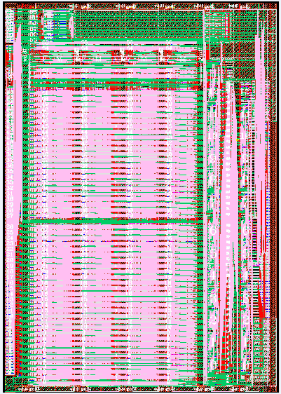
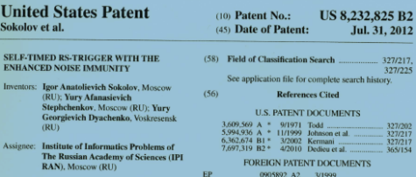
Cell library approbation
ST-circuitry: methodology, libraries, CAD tools, implementation
Functional description (VHDL, Verilog)
SI-VLSI CADs
SI-cell Libraries
Kovcheg
ASPECT
ASYAN
FAZAN
TASKAN
SYNTABIB
САМАН
GA 5503
GA 5507
GA 5521
GA 5529
180 nm
65 nm
20 RF patents
2 USA patents
25 registered programs
Special-purpose and Test SI-VLSI
Microcontroller Core (CMOS GA 5503)
Coder-Decoder (CMOS GA
5507/5521)
Divider & Square-Rooter (180-nm, 65-nm CMOS)
Fused Multiply-Add (180-nm, 65-nm CMOS)
Increase of steady operation range (10-15 times); decrease of energy consumption (30-50%); rise of performance (100-250%); detection of constant malfunctions (up to 100%)
IPI RAS EWDTS-2015 16

Slide 19
Conclusions
Suggested library:
Corresponds to the criteria of building SI-circuits,
Contains more than 200 library cells expanding standard cell libraries,
Provides really SI solutions for interfacing with synchronous environment and for driving large loads
IPI RAS EWDTS-2015 19

Slide 20
Thanks!
IPI RAS EWDTS-2015 20

Slide 21
Contacts
Director: academician Sokolov I.A.
Address: Institute of Informatics Problems of the Federal Research Center "Computer Science and Control" of the Russian Academy of Sciences (IPI RAS), Moscow, Russian Federation, 119333, Vavilova str., 44, b.2
Tel: +7 (495) 137 34 94
Fax: +7 (495) 930 45 05
E-mail: ISokolov@ipiran.ru
Stepchenkov Y.A., tel. +7 (495) 671 15 20, Ystepchenkov@ipiran.ru
IPI RAS EWDTS-2015 21

