Slide 1
Increasing Self-Timed Circuit Soft Error Tolerance
Igor Sokolov, Yury Stepchenkov, Yury Diachenko, Yury Rogdestvenski, and Denis Diachenko
Federal Research Center "Computer Science and Control" of the Russian Academy of Sciences, FRC CSC RAS, Moscow, Russian Federation

Slide 2
Outline
Synchronous and Self-Timed circuits
Self-Timed circuit’s soft-error tolerance
Indication subcircuit implementation
How to increase indication subcircuit immunity to soft-errors?
Conclusions
FRC CSC RAS EWDTS-2020 2 of 22

Slide 3
Circuits classification
All digit circuits
Asynchronous (clock free!)
Self- Timed (ST)
Others
Synchronous (clocks!)
Full switching completion indication
FRC CSC RAS EWDTS-2020 3 of 22

Slide 4
Self-timed principles
Two operation phase:
work phase (data processing)
spacer (pause)
Dual-rail information signal coding in combinational circuits
Full indication of all circuit’s cells in each operation phase
FRC CSC RAS EWDTS-2020 4 of 22

Slide 5
ST circuit’s Features
Advantages:
Their workability does not depend on delay of their cells and wires
Extremely wide workability range on supply voltage and ambient temperature,
Constant failure detection and localization
High soft error immunity
Draw-backs:
Increased hardware complexity
Lower performance in multi-bit data processing
FRC CSC RAS EWDTS-2020 5 of 22

Slide 6
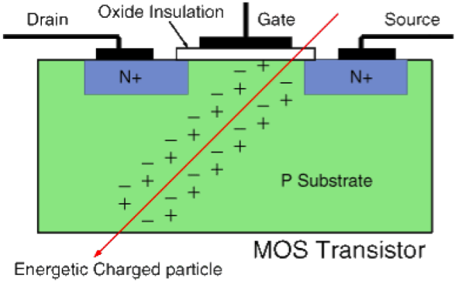
Soft error sources
Ionization current
Nuclear particles and cosmic rays
External electro-magnetic pulse
Cross-talks on signal wires
Noise on power stripes
Substrate noises
VDD
A
B
VSS
Noises
FRC CSC RAS EWDTS-2020 6 of 22

Slide 7
Dual-rail coding
Two work states and one spacer
Dual-rail value | Spacer type
 | Null | Unit
01 | Work state | Work state
10 | Work state | Work state
00 | Spacer | Anti-spacer
11 | Anti-spacer | Spacer
Anti-spacer is a state inverse to spacer. It is usually prohibited
FRC CSC RAS EWDTS-2020 7 of 22

Slide 8
Indication Subcircuit BASIS
Solution: Let’s indicate anti-spacer as the second spacer by XOR / XNOR cell
XOR circuitry
A
B
Y
A
B
Y
Standard cell basis
CMOS transistors basis
FRC CSC RAS EWDTS-2020 8 of 22

Slide 9
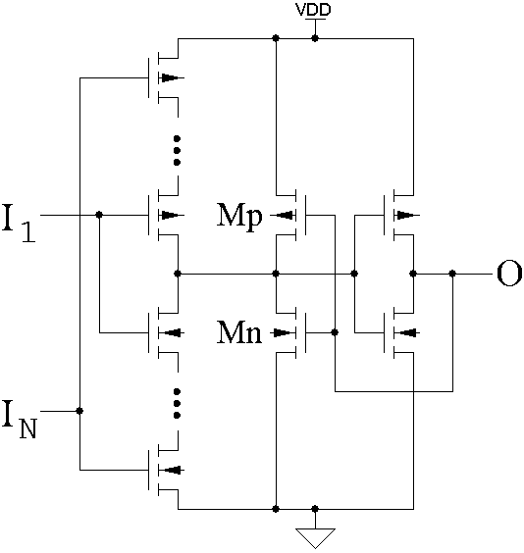
Indication circuitRY
O⁺ = I₁⋅I₂⋅… ⋅I_{N} + O⋅(I₁ + I₂ +…+ I_{N})
Semi-static Muller’s C-element:
+ Short-circuit current when switching
−Minimal complexity
FRC CSC RAS EWDTS-2020 9 of 22

Slide 10
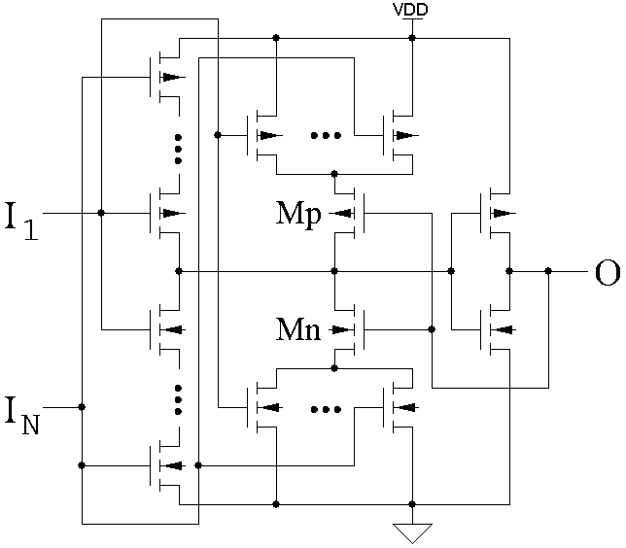
Indication circuitRY
O⁺ = I₁⋅I₂⋅… ⋅I_{N} + O⋅(I₁ + I₂ +…+ I_{N})
Static Muller’s C-element or Hysteretic trigger:
+ Short-circuit current is absent
− Increased complexity
FRC CSC RAS EWDTS-2020 10 of 22

Slide 11
DICE-like semi-static C-element
I₁
I₂
O
N₃
N₂
N₁
FRC CSC RAS EWDTS-2020 11 of 22

Slide 12
DICE-like static C-element
I₁
I₂
O
N₃
N₂
N₁
FRC CSC RAS EWDTS-2020 12 of 22

Slide 13
DICE-like semi-static C-element
I₁
I₂
O
N₃
N₂
N₁
FRC CSC RAS EWDTS-2020 13 of 22

Slide 14
DICE-like static C-element
I₁
I₂
N₂
O
N₃
N₁
FRC CSC RAS EWDTS-2020 14 of 22

Slide 15
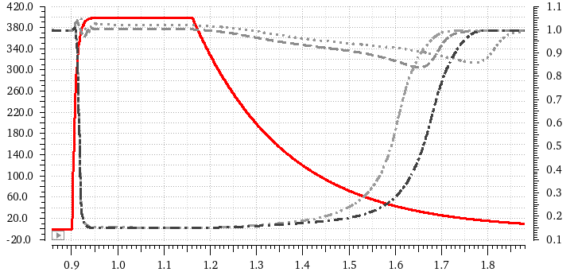
C-elements comparison (1)
The influence of ionization current pulse (A = 400 uA, t_{R} = 7 ps, t_{F} = 200 ps, “plateau” = 200 ps) at node N₁
I_{IC}, uA
Improved cases
Initial cases
V(O), V
t, ns
FRC CSC RAS EWDTS-2020 15 of 22

Slide 16
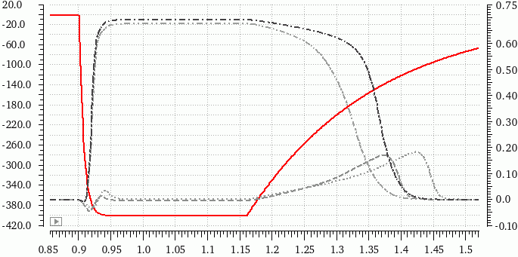
C-elements comparison (2)
The influence of ionization current pulse (A = −400 uA, t_{F} = 7 ps, t_{R} = 200 ps, “plateau” = 200 ps) at node N₃
I_{IC}, uA
Improved cases
Initial cases
V(O), V
t, ns
FRC CSC RAS EWDTS-2020 16 of 22

Slide 17
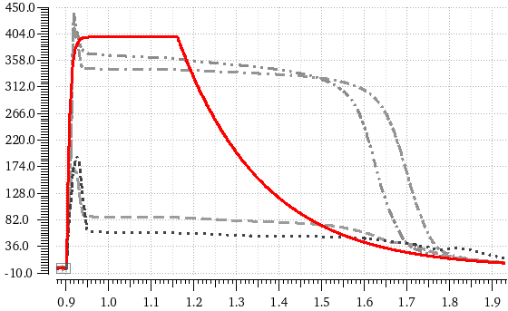
C-elements comparison (3)
Consumption current during soft error
I_{CC}, uA
Improved cases
Initial cases
t, ns
FRC CSC RAS EWDTS-2020 17 of 22

Slide 18
In-phase C-elements
C-element with in-phase input and output pairs masks soft error induced directly at any its output
O₁
J₁
I₁
I₂
J₂
O₂
FRC CSC RAS EWDTS-2020 18 of 22

Slide 19
Indication subcircuit structure
A
AB
B
BB
C
CB
D
DB
O
FRC CSC RAS EWDTS-2020 19 of 22

Slide 20
Summary
Soft error tolerance of the indication subcircuit largetly determines entire self-timed circuit’s tolerance
XOR or XNOR cells at the first stage of the indication subcircuit prevent the errors caused by anti-spacer state
Four-transistor output cascade makes the DICE-like C-element entirely immune to single soft errors at its internal and input nodes
The proposed indication subcircuit building technique doubles its hardware complexity but ensures its absolute immunity to the short-term soft errors
FRC CSC RAS EWDTS-2020 20 of 22

Slide 21
Thank You!
FRC CSC RAS EWDTS-2020 21 of 22

Slide 22
Contacts
Director: academician Sokolov I.A.
Address: Institute of Informatics Problems of the Federal Research Center "Computer Science and Control" of the Russian Academy of Sciences (IPI RAS), Moscow, Russian Federation, 119333, Vavilova str., 44, b.2
Tel: +7 (495) 137 34 94
Fax: +7 (495) 930 45 05
E-mail: ISokolov@ipiran.ru
Stepchenkov Y.A., tel. +7 (495) 671 15 20, Ystepchenkov@ipiran.ru
FRC CSC RAS EWDTS-2020 22 of 22

