Slide 1
Energy Efficient Speed-Independent 64-bit Fused Multiply-Add Unit
Y. Shikunov, Y. Stepchenkov, Y. Rogdestvenski, Y. Diachenko, D. Stepchenkov
Institute of Informatics Problems, Federal Research Center
"Computer Science and Control" of Russian Academy of Sciences

Slide 2
Content
Features of the Speed-Independent circuits
Flowchart of the Speed-Independent FMA
Ways for increasing FMA performance
Pipelining multiplier
Input and output FIFO implementation
ElConRus2019 2

Slide 3
Speed-independent (SI) circuits
Advantages:
lack of hazards,
self-testing,
real performance,
wide workability range.
Disadvantages :
design difficulty,
higher hardware costs,
increased number of signals
ElConRus2019 3

Slide 4
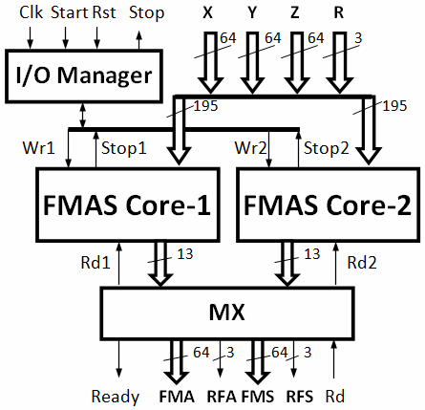
Flow-chart of previous SI FMA
ElConRus2019 4

Slide 5
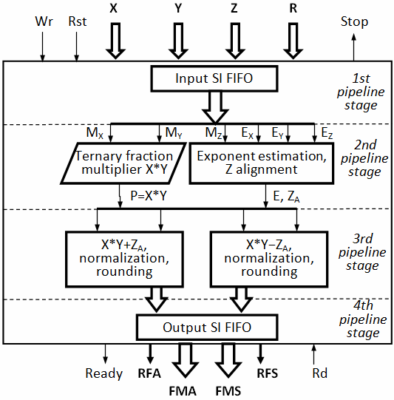
Flow-chart of new SI FMA
ElConRus2019 5

Slide 6
Quaternary encoding
Number | Binary redundant code |  | Quaternary code
 | A | B | AP | AM | A0 | A0N
+1 | 1 | 0 | 1 | 0 | 0 | 1
0 | 0 | 0 | 0 | 0 | 1 | 0
−1 | 0 | 1 | 0 | 1 | 0 | 1
spacer | − | − | 0 | 0 | 0 | 0
ElConRus2019 6

Slide 7
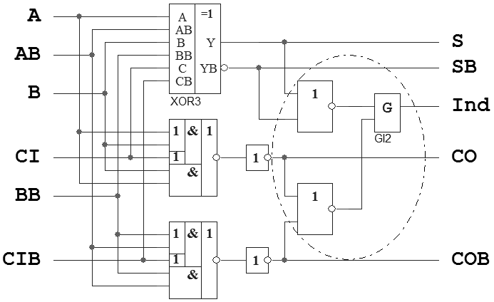
Dual-rail SI adder
68 CMOS transistors,
3:2 Compression
ElConRus2019 7

Slide 8
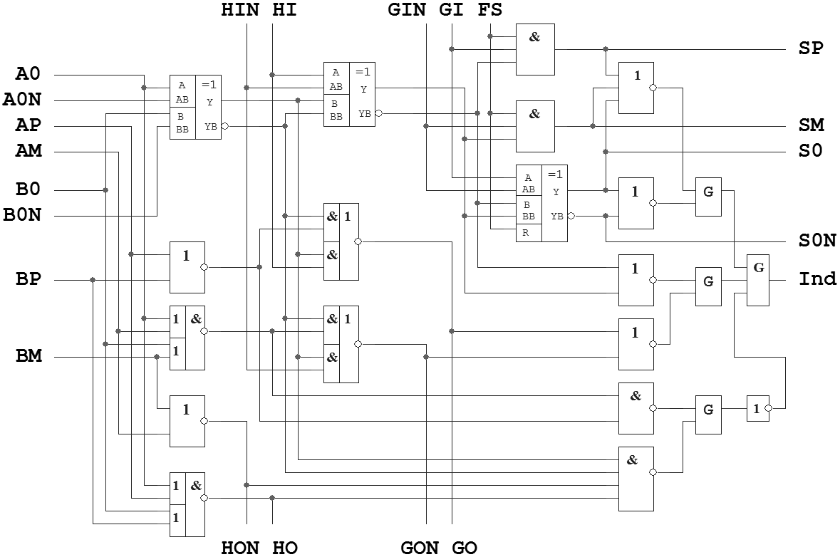
Quaternary SI adder
+1
0
n0+1
−1
− 1
0
0
n0
+1
−1
n0
180 CMOS transistors; 2:1 Compression
ElConRus2019 8

Slide 9
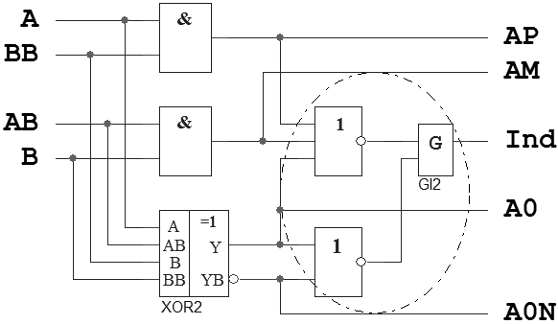
Two Dual-Rails to Quaternary converter
{A,AB} – {B,BB} = {AP,AM,A0,A0N}
48 CMOS transistors
ElConRus2019 9

Slide 10
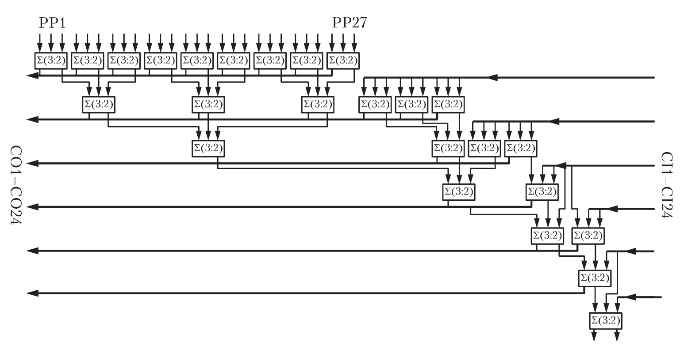
Dual-rail SI implementation of the Wallace tree: 7 Stages
ElConRus2019 10

Slide 11
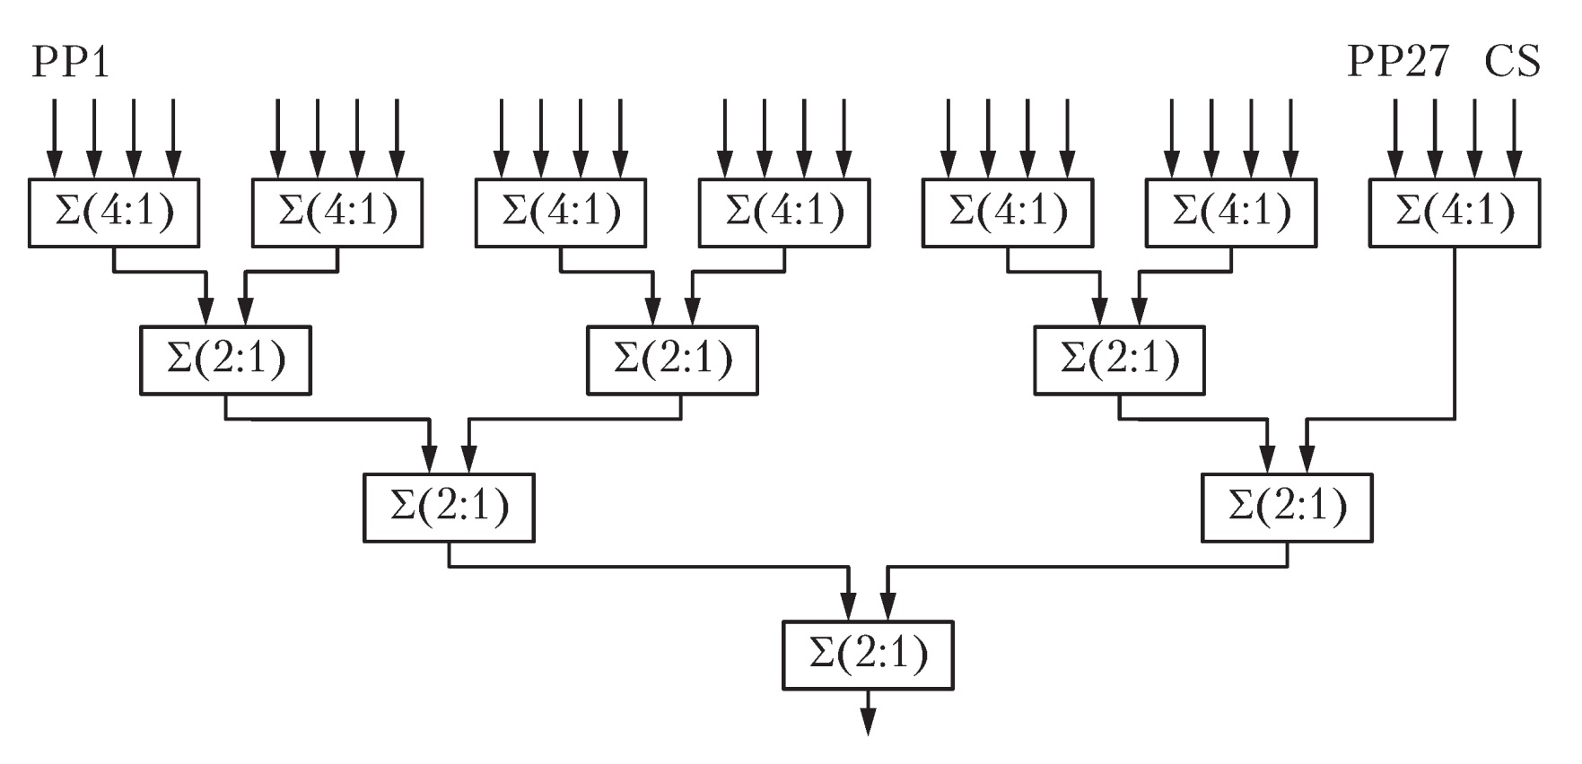
Quaternary SI implementation of the Wallace tree: 4 Stages
ElConRus2019 11

Slide 12
Acceleration techniques
Forced transition of the Wallace tree adders into spacer phase.
Providing simultaneous switching Booth encoder together with some part of the Wallace tree layers into spacer phase and executing complete work cycle by remaining Wallace tree layers.
ElConRus2019 12

Slide 13
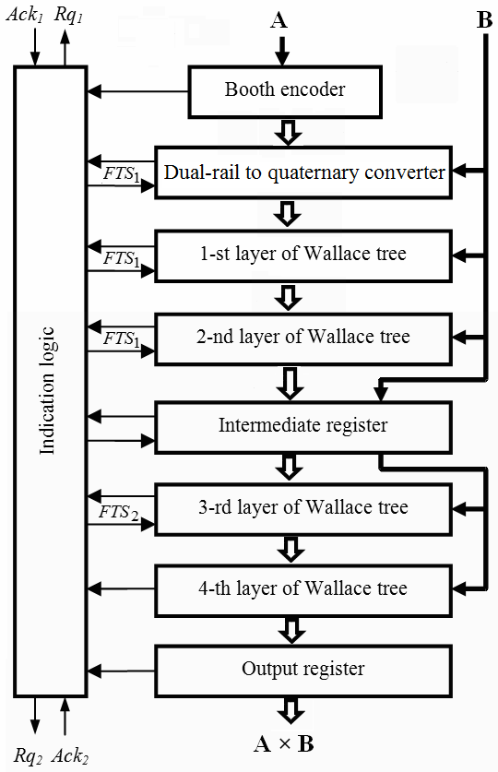
Forced transition to spacer
ElConRus2019 13

Slide 14
Variants of SIFMA multiplier
Variant | Pipeline stages | Latency, ns | Complexity, CMOS transistors
Maximum performance | 3 | 1.0 | 410 000
Minimum complexity | 1 | 2.6 | 190 000
Combined features | 1 | 1.3 | 320 000
Synchronous base unit | 1 | 1.3 | 125 300
ElConRus2019 14

Slide 15
SI FIFO: Semi-Dense Unit
Features per one bit for 4 words capacity :
88 Interconnections
258 CMOS transistors
ElConRus2019 15

Slide 16
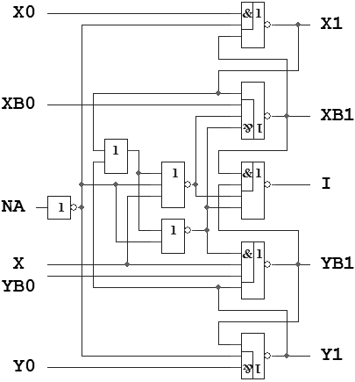
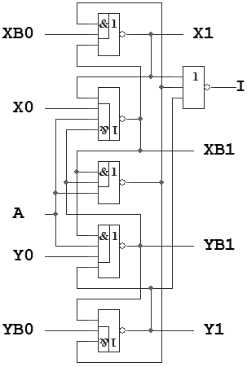
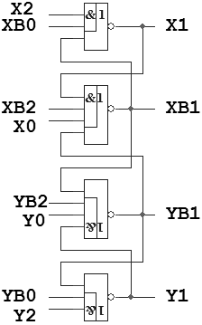
Semi-Dense SI FIFO: Schematic
Input Head Internal Cell Output Head
ElConRus2019 16

Slide 17
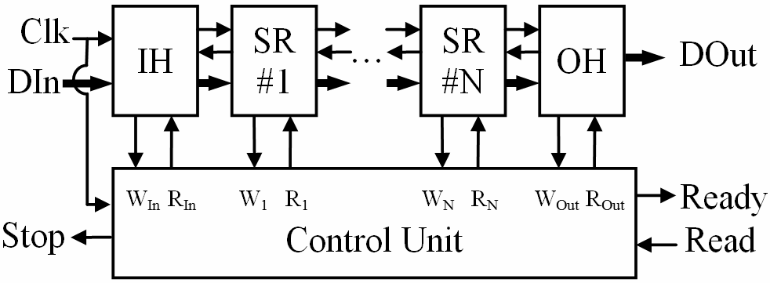
SI FIFO: Dense Unit
Features per one bit for 4 words capacity:
38 Interconnections
140 CMOS transistors
ElConRus2019 17

Slide 18
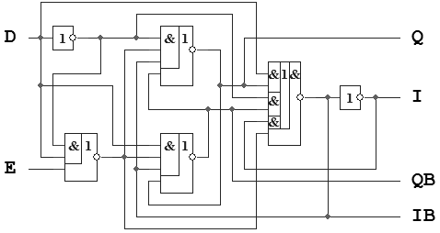
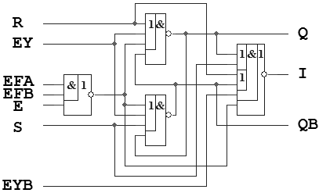
Dense SI FIFO: Schematic
Input Head Other Cells
ElConRus2019 18

Slide 19
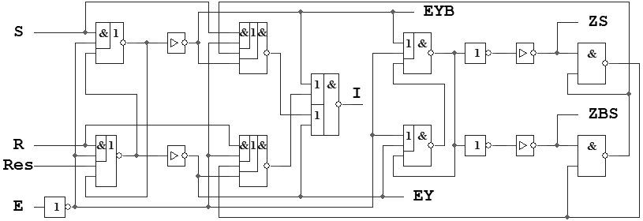
Dense FIFO: Control Unit
ElConRus2019 19

Slide 20
Conclusions
Development of the SI circuits is always a compromise between their performance and complexity. The necessity of an indication of all cells in the designed SI circuit significantly affects this compromise
Three-stage pipeline implementation of SI multiplier provides 3 Gflops performance of the SI FMA
Single-stage multiplier release provides the best "performance/complexity" ratio and the highest energy-efficiency
Proposed few-stage SI FIFO on basis of SI dense shift register provides the best characteristics and higher energy-efficiency
ElConRus2019 20

Slide 21
Contacts
Director: Academician Igor Sokolov
Address: Institute of Informatics Problems, Federal Research Center “Computer Science and Control" of the Russian Academy of Sciences,
44 b.2 Vavilova str., Moscow, 119333
Phone: +7 (495) 137 34 94
Fax: +7 (495) 930 45 05
E-mail: isokolov@ipiran.ru
Speaker: Shikunov Yury yishikunov@gmail.com
ElConRus2019 21

