Slide 1
Self-Timed Circuitry Retrospective
Victor Zakharov, Yury Stepchenkov, Yury Diachenko, Yury Rogdestvenski
Federal Research Center “Computer Science and Control” of Russian Academy of Sciences

Slide 2
contents
Self-timed circuit – what is it?
Self-timed circuit features
Self-timed Micro Core
Self-timed Coprocessor
Self-timed circuit optimization
Conclusions

Slide 3
Circuits Design methodologies
Digital circuits
Synchronous
Circuits
Asynchronous
Circuits
Self-timed
Circuits

Slide 4
Self-timed Circuit features
Advantages:
Stable operation under any operating conditions
Wide range of workability
Natural full self-checking concerning constant faults
Lack of overhead hardware and energy costs associated with global clock tree
Drawbacks:
Hardware redundancy
Increased number of signals

Slide 5
Self-timed Circuit types
Quasi-Speed-Independent (QSI) circuits
Do not depend on cell’s delays
Critical path indication only
Speed-Independent (SI) circuits
Do not depend on cell’s delays
Full indication
Purely self-timed in isochronous zone
Delay-Insensitive (DI) circuits
Do not depend on delays both in cells and wires
Full indication

Slide 6
isochronous zone
Delay in any wire is less than the least delay of any library cell
In 1-μm and higher CMOS process
In deep submicron CMOS process

Slide 7
Speed-independent Circuit base principles
Two-phase operation mode: working phase and spacer
The use of dual-rail, biphasic and unary information signals
Acknowledging the switching of all circuit cells by an additional indication subcircuit
Handshake between subsequent functional blocks in the information processing path
Unlimited circuitry basis

Slide 8
Delay-insensitive Circuit base principles
NULL Convention Logic (NCL) is a typical representative of the DI circuits
Two-phase operation mode: working phase and spacer
The use of dual-rail only information signals
Each cell indicates all own inputs
Limited multi-threshold cell library (29 cells)

Slide 9
SI and NCL Circuits comparison
 | SI circuits | NCL circuits
Advantages | Less complexity (up to 2 times for combinational circuits and up to 4 times for sequential ones) Unlimited cell basis Analysis software | Simple indication (only circuit outputs should be indicated) Easier design automation (BALSA, UNCLE)
Drawbacks | Additional indication subcircuit controlling all circuit cells Hard formalization for design automation | Large complexity both of combinational and sequential circuits Less performance Larger power consumption

Slide 10
Software for SI circuit design developed in FRC “CSC”
Self-timing properties analysis:
Library cell level analysis (BTRAN, ASIAN)
Functional block level analysis (ASPECT)
VLSI level hierarchical analysis (LIMAN)
SI circuit synthesis:
Custom and gate arrays base
Industrial standard cell libraries extended by self-timed combinational and sequential cells

Slide 11
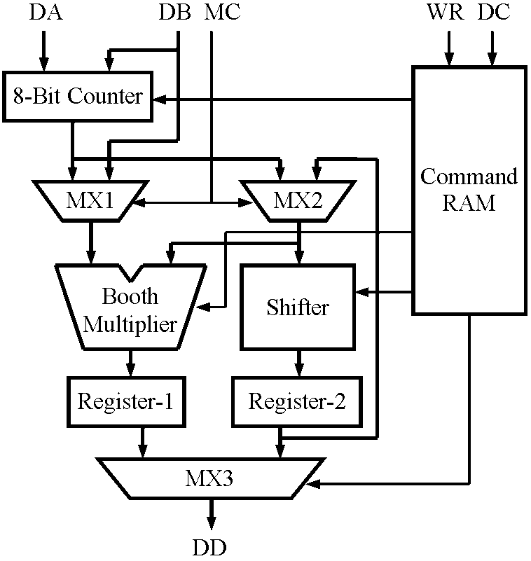
SI circuit examples: Micro core
Instruction Set:
MUL – multiply 4×4
ROT – cyclic shift
JUMP – unconditional jump
NOP – no operation
CMOS Process
1.6 μm
1 metal, 1 polysilicon
Gate Array

Slide 12
SI circuit examples: Micro core
Operation cycle duration for command sets
 | Operation set | Synch-ronous, ns | Speed-independent, ns
 |  | typical | worst | typical | best
1 | Cyclic MUL | 250 | 166 | 144 | 118
2 | Cyclic ROT | 250 | 121 | 102 | 86
3 | Cyclic NOP | 250 | 111 | 93 | 75
4 | Cyclic JUMP | 500 | 90 | 78 | 66
5 | MUL + JUMP + NOP + ROT | 1248 | 516 | 440 | 364

Slide 13
SI circuit examples: Micro core
Hardware complexity on Gate Array basis
 | Hardware | Synchronous, gates | Speed-independent, gates
1 | Multiplier | 177 | 444
2 | Shifter | 52 | 214
3 | Counter | 88 | 159
4 | Command RAM | 230 | 192
5 | Control unit | 423 | 380
 | Total | 970 | 1389

Slide 14
SI circuit examples: Micro core
Workability region
U_{DD}, V
Synchronous
Speed-independent
T, °C

Slide 15
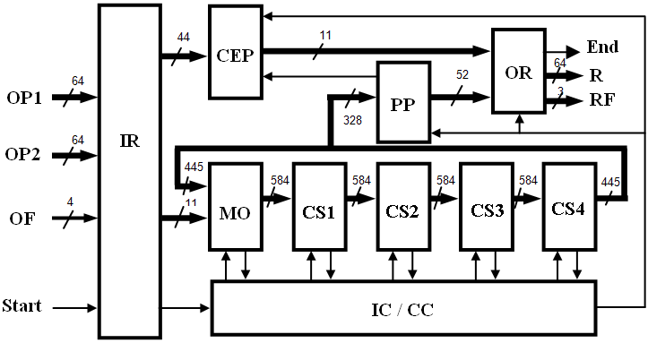
SI circuit examples: coprocessor

Slide 16
SI circuit examples: coprocessor
Manufactured cases comparison
24
QSI
0.35
19
S-N
0.40
8
S-SRT
0.30
Performance, MOPS
Die size, mm²

Slide 17
SI circuit examples: coprocessor
QSI and SI cases’ performance, ns
 | Conditions |  | QSI case |  | SI case
 | U_{DD}, V | T, °C | DIV | SQRT | DIV | SQRT
1 | 1.98 | −63 | 34.7 | 36.9 | 47.3 | 50.2
2 | 1.80 | 25 | 46.7 | 49.1 | 63.5 | 67.0
3 | 1.62 | 125 | 63.9 | 70.3 | 86.9 | 90.1
4 | 0.32 | 125 | 25 688 | 25 301 | 34 940 | 34 410
5 | 0.20 | 125 | - | - | 340 800 | 336 920

Slide 18
SI circuit structure
Factors limiting performance:
Two-phase operation discipline
An indication subcircuit acknowledging switching completion into the current phase
Indicated circuit
Y
X
Indication subcircuit
Ind

Slide 19
SI circuit pipeline
Traditional indication
Stage 1
Stage 2
Stage 3
Logic
Register
Logic
Register
Logic
Register
C
C
C

Slide 20
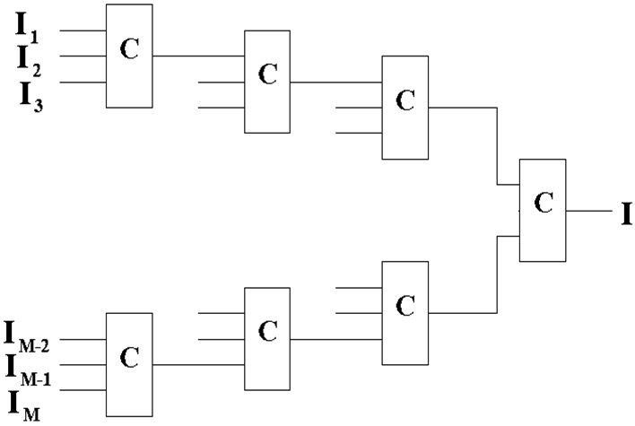
Indication subcircuit structure
t_{IC} = t_{C3} ⋅ ]log₃M[ + t_{C2}

Slide 21
Indication subcircuit optimization
Bitwise indication of the Logic in the same stage Register
Bitwise control of the previous stage Register
Stage 1
Stage 2
Stage 3
Logic
Register
Logic
Register
Logic
Register
...
...
...
...
...

Slide 22
Indication subcircuit optimization
I_{L} is a bitwise indication output of the Logic
I_{R} is a bitwise indication output of the Logic
I_{L} delay is bigger than others input delays
I_{L} delay is close to others input delays

Slide 23
Bitwise Indication rule
Each output controls only those inputs, which it depends on.
Connectivity coefficient “K”:
X_{N} X_{N−1} X_{N−2} … X₃ X₂ X₁
K1 = 2
K2 = 1
K3 = 3
Y_{M} Y_{M−1} Y_{M−2} … Y₆ Y₅ Y₄ Y₃ Y₂ Y₁

Slide 24
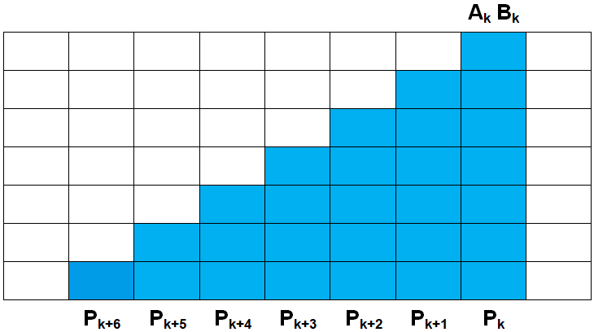
Wallace tree Bitwise Indication
For one-stage 54-bit Wallace tree, K = 7
Layer 1
Layer 2
Layer 3
Layer 4
Layer 5
Layer 6
Layer 7

Slide 25
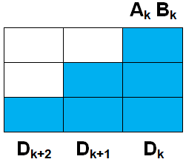
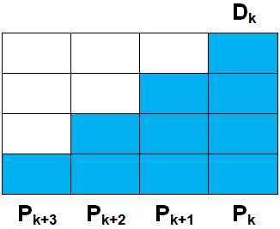
Wallace tree Bitwise Indication
For two-stage 54-bit Wallace tree: K₁ = 3; K₂ = 4
First WT stage
Second WT stage
Layer 1
Layer 2
Layer 3
Layer 4

Slide 26
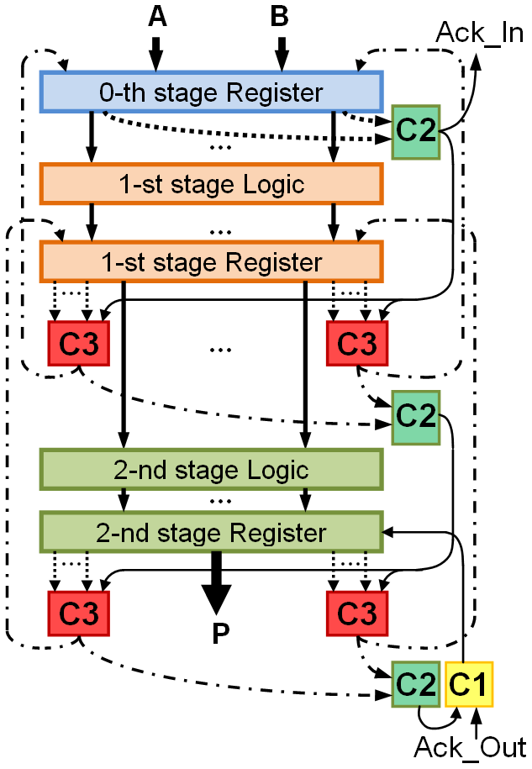
WT’s pipeline Bitwise Indication
Bitwise indicators
Total indicators
Group indicators

Slide 27
WT’s pipeline Bitwise Indication
Simulation results and hardware estimates (65-nm bulk CMOS process)
Indication case | Average cycle duration, ps | Complexity, CMOS transistors
Classical | 970 | 220 000
Bitwise & group | 710 | 225 500

Slide 28
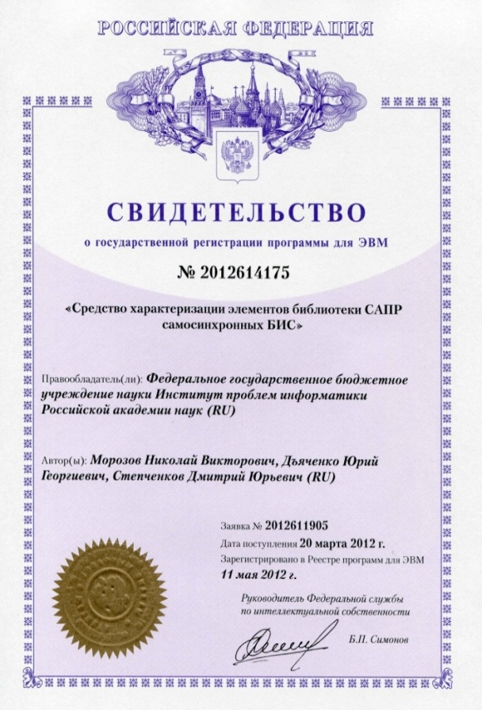
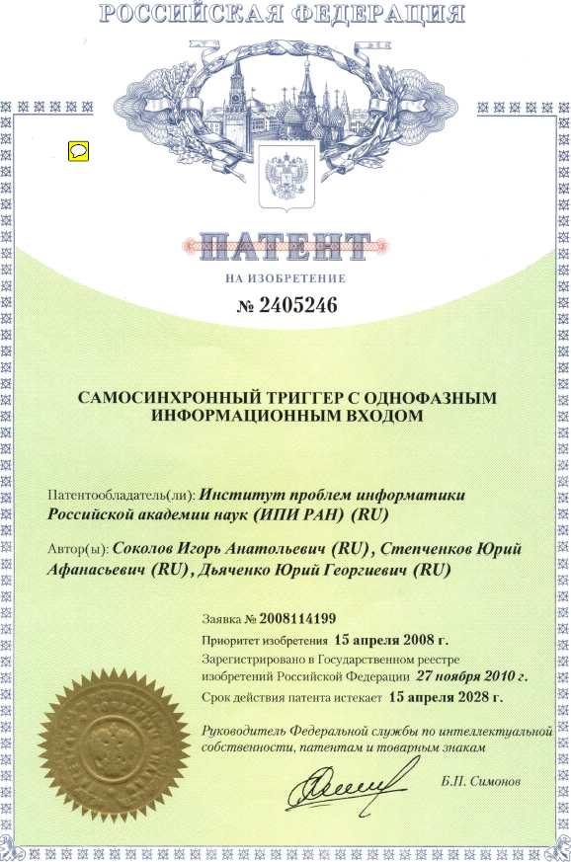
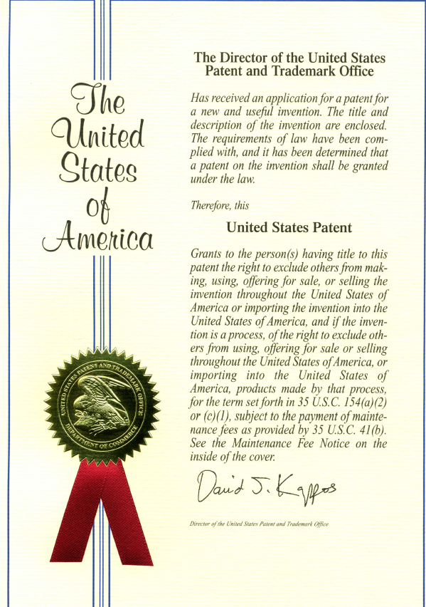
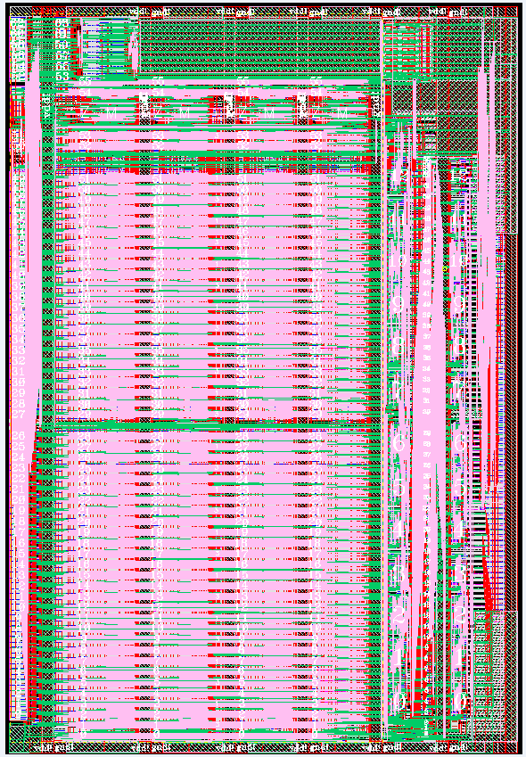
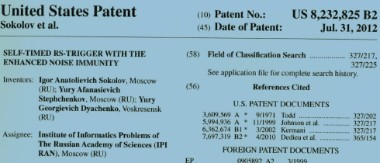
Self-timed circuits: Design methodology, Cell libraries, CAD tools, and Product prototypes
Functional description (VHDL, Verilog)
ST VLSI CAD
ST cell libraries
ASPECT
ASIAN
FAZAN
TASKAN
SINTABIB
SAMAN
LIMAN
GA 5503
GA 5509
GA 5521
CMOS 180 nm
CMOS 65 nm
28 registered software tools
37 RU patents
2 USA patents
Custom ST LSI & VLSI
Microcontroller core (GA 5503)
Codec
(GA 5507)
Arithmetic coprocessor IEEE 754 (180 nm)
Arithmetic coprocessor IEEE 754 (65 nm)
Fused Multiply-Add Unit IEEE 754
(65 nm)
Workability range increase (3-10 times); reduced power consumption (30-50%), increased performance (25-100%); constant fault detection (up to 100%)

Slide 29
Conclusions
Speed-independent (SI) circuitry is justified primarily in areas where high operational reliability is a determining factor
Experimental results proved SI circuits advantages in the workability range and performance. In real conditions, typical computing speed-independent units with a low bit width of processed data have a better performance of 1.7 − 2.6 times than their synchronous analogs
The use of bitwise or group indication and control in multi-bit SI circuits significantly accelerates their work at the expense of a relatively small increase in hardware complexity

Slide 30
contacts
Address: Institute of Informatics Problems, Federal Research Center “Computer Science and Control” of Russian Academy of Sciences, Russia, 119333, Moscow, Vavilov str., 44, building 2
Director: academician Sokolov I.A.
Tel.: +7 (495) 137 34 94
Fax: +7 (495) 930 45 05
E-mail: ISokolov@ipiran.ru
Speaker: Diachenko Y.G., YStepchenkov@ipiran.ru
Support
The research was carried out within the framework of state task No. 0063-2019-0010

