Slide 1
Graph-capsule construction toolset for data-flow computer architecture*
Yury Shikunov, Yury Stepchenkov, Dmitry Khilko, George Orlov
Institute of Informatics Problems, Federal Research Center "Computer Science and Control" of the Russian Academy of Sciences, (IPI FRS CSC RAS), IPI RAS
*The study was partially by the 2017 subprogram № III.3.4 of ONIT RAS department (Project 0063-2016-0018 III.3).
Moscow, 2018
Notes:
Greetings Dear Colleagues, My name is Yury Shikunov from Moscow’s Institute of Informatics Problems. I work as junior researcher. Today I’d like to present a study called: ___
In this talk I’ll give the overview of existing computing architectures, describe the problems dataflow architectures encounter in terms of data redundancy, how we approached this problem, solutions we came to and the improvements to said solutions implemented we have developed since.

Slide 2
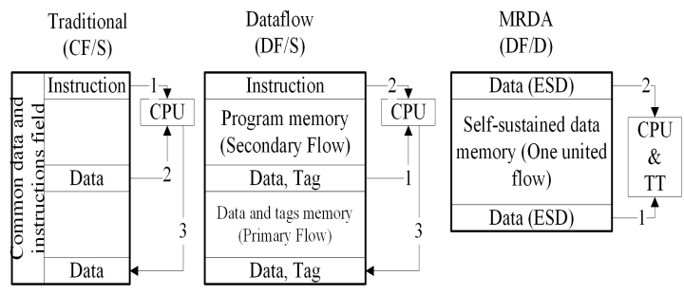
Key differences between MRDA and existing computer architectures
Main criteria – Instruction flow memory organization: Control-Flow/Static (CF/S), DataFlow/Static (DF/S), DataFlow/Dynamic (DF/D)
Notes:
I’d like to begin with the overview of existing computer architectures. In traditional Von-Neumann architectures, Data is accessed according to the flow of instructions, and if the data is not ready, the result will be wrong or an exception will be raised. To combat this, synchronization primitives were introduced. In the traditional Static Dataflow architecture, the Data and Instructions are represented as two different flows, and the computation is commenced when the elements of that flow are being matched according to the key.
We are developing the Dataflow-Dynamic architecture called Multicore Recurrent Dataflow Architecture, which is based on the two key features: Recurrency and Data self-sufficiency

Slide 3
MRDA Token Structure
Tags (Functional Fields) |  |  |  | Data
Field[0] | Field[1] | … | Field[N] | Content
Each Field[i] represents actual value of the parameter
We call such tokens – Operands
Capsule – An sequence of operands, representing the implementation of a single task.
Notes:
Development of such a capsule is a non-trivial task. We have tried applying existing means of programming to solve this, but found them insufficient. Therefore we have created our own specialized methodology.

Slide 4
Methodology Structure
Notes:
Here we can see the overall structure of said methodology. (Describe it quickly). The crucial part that we are covering today is Stage III- Capsule Programming Technique

Slide 5
Capsule Programming Technique
Notes:
Despite having theoretical methodology, we were limited by the existing tools. In the absence of debugging tools for modeling and execution of capsules, the distribution of architectural resources is a complex and time-consuming task. Therefore, in order to simplify the manual allocation of resources, a special graph notation for the representation of the computational process was developed, called a graph-capsule.

Slide 6
Capsule Programming Technique
Data-flow graph
Graph-capsule
Notes:
Here is an example of dataflow graph implementing Viterbi algorithm, and a corresponding graph-capsule representing the allocation of available resources.

Slide 7
Toolset environment
Notes:
One of our previous report covered the creation of the toolset for the development and debugging of the architecture and software for it called HARSP-IDE.
With the development of tools, as well as the accumulation of software development experience for MRDA, rules for the effective allocation of HARSP resources in typical programming situations have been accumulated.
For these typical situations, templates of capsule fragments have been created, that ensure the efficient distribution.
Using this, programming technique improvements were introduced.

Slide 8
Capsule Programming Technique Improvements
Notes:
The improvement of “technique of capsule programming” phase of the methodology has resulted in identifying following key steps:
1) Analysis of the mathematical description of the problem and construction of a data-flow graph for parallel algorithm;
2) Optimization of the data-flow graph according to the restrictions imposed by HARSP specification;
3) Construction of a dynamic data-flow graph by performing a recurrent convolution of subgraphs from the graph constructed in sub point 1);
4) Development of a capsule fragment that partially implements the dynamic graph;
5) Simulation of the capsule fragment by means of SIMPRA;
6) Establishment of the identity between the data-flow graph and simulation results;
The capsule is considered complete in case of exact congruence of the data-flow graph and simulation results, otherwise go to sub point 4).
In this formulation, the graph-capsule, as an inescapable element of capsule development process, has become much less relevant. However, the need for an in-depth analysis of simulation results also does not facilitate the simplification of the software development and debugging process. Therefore, the graph-capsule, as a necessary stage of debugging capsules, has not lost its relevance

Slide 9
Graph-capsule construction toolset
GraphViz – Graph construction middleware
Templates represent various atomic elements of the architectural resources
Notes:
We have created the graph-construction toolset on the base of the Graph construction middleware called GraphViz.
It was selected based on the several criteria, like vector graphics representation, documentation quality, licensing, and more.
GraphViz operates with it’s own graph description language dot. One of the features we heavily used was the ability to describe vertices via HTML.
The complete graph-capsule consists of separate computational steps, each described with a set of templates, specifying each architectural resource.
Those templates are then compiled and filled with SIMPRA modeling results before being rendered by GraphViz.

Slide 10
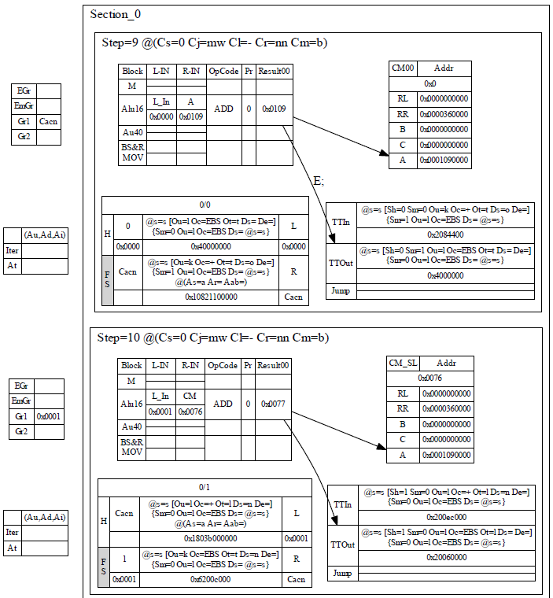
Graph-capsule construction toolset
Manual graph-capsule
Generated graph-capsule
Notes:
Here is an example of manually constructed graph-capsule, covering 4 computational steps, and the generated one, covering only 2 steps, but having much more information about the current resource utilization

Slide 11
Future developments
Interactive graph-capsule representation
Interactive data-flow graph representation
Partial capsule creation automation
Notes:
In the future, we plan on introducing the interactive graph-capsule representation of the ongoing modeling, allowing for interactive step-by-step debugging.
Using that framework we also plan to introduce some easy-of-use tools for creating initial data-flow graph.
And finally, as a first step towards compilation of high-level languages, we plan on introducing initial capsule generation based on the user-created dynamic graph

Slide 12
Thank you for your attention!
If you have any questions, feel free to write me an email at: YiShikunov@gmail.com

