Slide 1
Self-Timed Fused Multiply-Add Unit Performance Improvement
I. Sokolov, Y. Stepchenkov, Y. Rogdestvenski, Y. Diachenko, A. Rogdestvenskene, D. Diachenko
Institute of Informatics Problems, Federal Research Center
"Computer Science and Control" of the Russian Academy of Sciences

Slide 2
Content
What are the Self-timed circuits?
Fused multiply-add (FMA) unit structure
How can we accelerate self-timed FMA?
Practical techniques improving self-timed FMA’s performance
Conclusions
ElConRus2022 2 of 22

Slide 3
Self-Timed Circuits
They are free of global synchronization and operate based on a request-acknowledge interaction between circuit parts.
Major principles:
two-phase work discipline,
mandatory detection and acknowledging completion of all switches initiated during the transition to the current phase of work
ElConRus2022 3 of 22

Slide 4
Self-Timed Circuit’s Advantages
Absence of a global clock tree accounting for up to 30% of total power consumption
Absence of "races" between internal signals
Correct operation under any operating conditions (supply voltage and ambient temperature)
Their performance is determined by the actual logic cells' delays in the current operating conditions, not the worst case
ElConRus2022 4 of 22

Slide 5
Self-Timed Circuit’s Drawbacks
Increased hardware complexity because of redundant data coding and indication subcircuit
Two-phase operation mode decelerates self-timed circuit’s total performance
Indication subcircuit causes an additional delay increasing in multi-bit units
Direct conversion of synchronous circuits to self-timed ones can lead to ineffective solutions in performance or an excessive hardware costs
ElConRus2022 5 of 22

Slide 6
Fused multiply-add (FMA) unit
C[63:0]
A[63:0]
B[63:0]
Align
A × B
3:2 CSA
LZA
Adder
Normalizer
Round & Post-Normalizer
Result
ElConRus2022 6 of 22

Slide 7
Cases simplifying calculations
exp(C) − exp(A × B ) | Result | Normalization order | Round
[57, ∞) | C | − | −
[2, 56] | A × B ± aligned_C | n | +
[−1, 1] | A × B ± aligned_C | n | +
[−55, −2] | A × B ± C | 1 | +
(−∞, −56] | A × B | 1 | +
ElConRus2022 7 of 22

Slide 8
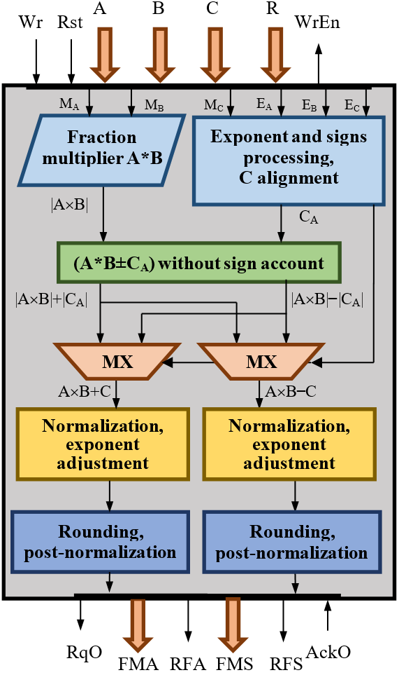
Self-Timed Fused Multiply-Add-Subtract (FMAS) Unit
A, B, C – input operands
R – operation options
Wr – force write input
Rst – asynchronous reset
WrEn – write enable output
RqO – result ready output
FMA – multiply-add result
FMS – multiply-subtract result
RFA – flags of FMA operation
RFS – flags of FMS operation
AckO – read result acknowledging
IEEE 754 Standard Compliant
Ternary multiplier and adder-subtractor
ElConRus2022 8 of 22

Slide 9
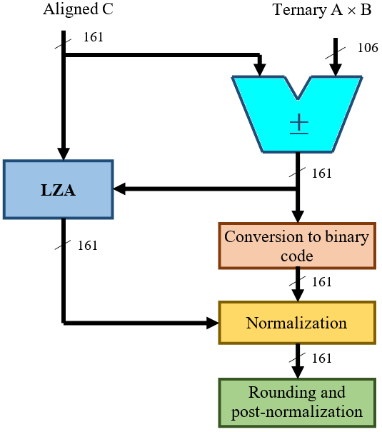
Increasing FMAS Performance (1)
Ternary coding simplifies and accelerates adding-subtracting multi-bit operands
ElConRus2022 9 of 22

Slide 10
Increasing FMAS Performance (2)
An important feature of the self-timed circuits: their operation time depends on the processed data
Rule 1: Do not tie the estimated operating time of individual units and pipeline stages to the maximum time for the worst operating conditions, but use the statistically average operating time.
Rule 2: Use new algorithmic solutions that may be ineffective in synchronous circuitry as they decrease the unit's performance in the worst case.
ElConRus2022 10 of 22

Slide 11
Increasing FMAS Performance (3)
The ways to increase self-timed FMAS performance:
• Using LZA pre-calculation with reduced bit-width
• Reducing bit-width of output registers for sum and difference of the product and the third operand due to parallelization of data processing.
• Speeding up normalization and post-normalization.
ElConRus2022 11 of 22

Slide 12
Optimized Normalization (1)
The main idea of the proposed improvement:
Align the largest of the third operand or product in the most significant bits of the adder-subtractor,
Shift the rest one by order corresponding to the difference of their exponents.
ElConRus2022 12 of 22

Slide 13
Optimized Normalization (2)
Typical algorithm for the case “exp(C) – exp(A × B)” ∈ [2, 56]
A × B
107 0
±
Shift by order [2, 56]
C
55
107 55
160 52 0
55 0
Normalization
Normalization order < 107
52 0
Rounding
ElConRus2022 13 of 22

Slide 14
Optimized Normalization (3)
Proposed algorithm for the case “exp(C) – exp(A × B)” ∈ [2, 56]
Shift by order [2, 56]
A × B
107 55
C
160 108
±
160 55
55 0
Normalization
Normalization order < 57 !
52 0
Rounding
ElConRus2022 14 of 22

Slide 15
Optimized Normalization (4)
Typical algorithm for the case “exp(C) – exp(A × B)” ∈ [–56, –2]
A × B
107 0
±
Shift by order [2, 56]
C
107 55
160 0
55 0
Normalization
Normalization order < 107
52 0
Rounding
ElConRus2022 15 of 22

Slide 16
Optimized Normalization (5)
Proposed algorithm for the case “exp(C) – exp(A × B)” ∈ [–56, –2]
160 52
A × B
Shift by order [2, 56]
160 108
±
C
160 52
Normalization order < 57 !
55 0
Normalization
52 0
Rounding
ElConRus2022 16 of 22

Slide 17
Optimized Normalization (6)
Optimization results:
1. The bit-width of the operand to be normalized is reduced from 161 to 106
2. The duration of all basic operations of the critical cycle is decreased by 15 – 20 %
3. Hardware complexity of the self-timed fused multiply-add-subtract unit is efficiently reduced
ElConRus2022 17 of 22

Slide 18
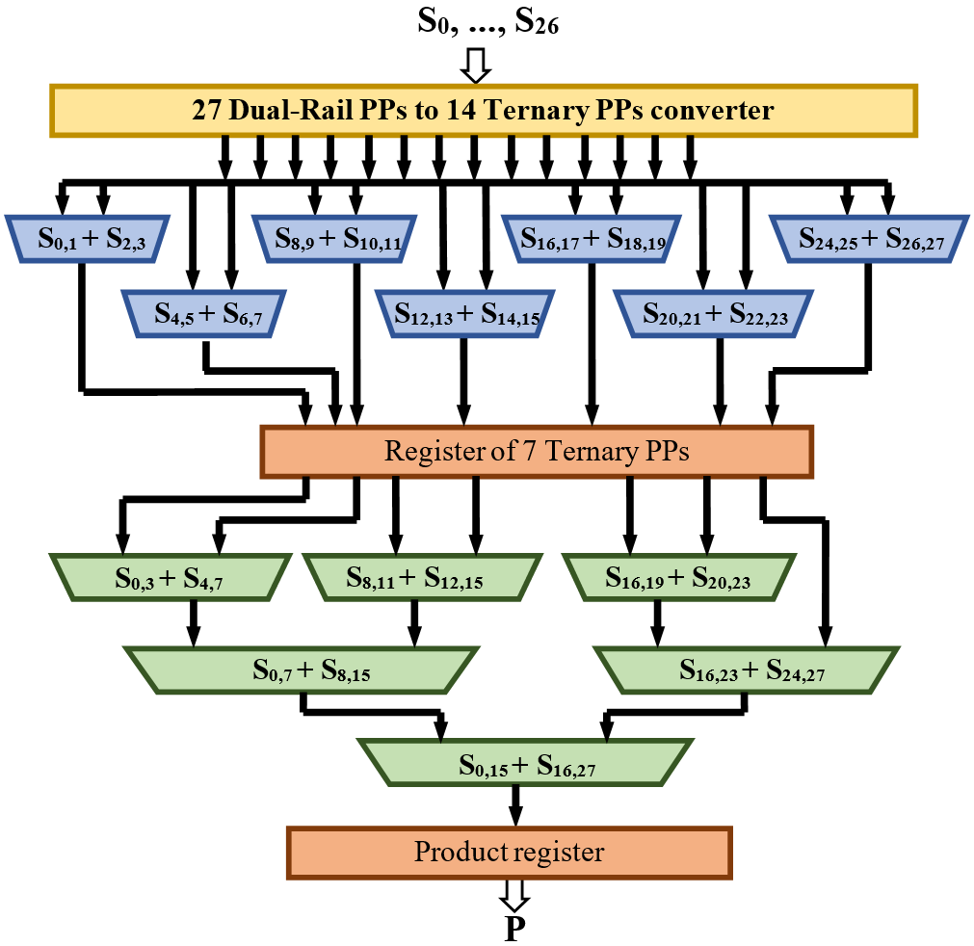
Ternary Wallace Tree
1-st stage
2-nd stage
80 S_{16,27} 0
80 S_{0,15} 0
26 bits
ElConRus2022 18 of 22

Slide 19
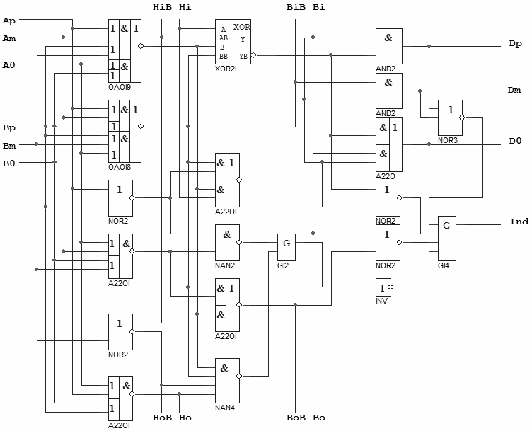
Carry Propagation Paths in the Ternary Adder
Hi Bi
A D
B Ind
Ho Bo
Hi Bi
A D
B Ind
Ho Bo
Hi Bi
A D
B Ind
Ho Bo
ElConRus2022 19 of 22

Slide 20
LZA Unit
24-bit Subtraction
Leading zeros counting (N_{LZ})
A × B
23 0
−
“000010110…”
C
23 0
Part 1
Yes
N_{LZ} < 24 ?
Normalization order = N_{LZ}
No
Normalization order must be calculated
Part 2
ElConRus2022 20 of 22

Slide 21
Conclusions
Self-timed circuit operation discipline allows for wider using speculative result calculation techniques on a base of detailed specifying the possible cases of the input operands ratio
The proposed normalization technique reduces a bit-width of processed data (by 1.5 times), duration of all primary operations of the critical cycle (in 15-20%), and hardware complexity (in 20-25%)
Preliminary estimation of the leading zero number of the most significant bits of product and third operand (24 for double precision or 12 for single precision) decreases by 32% an average delay, added by normalization pipeline stage to total Fused Multiply-Add-Subtract unit’s delay
ElConRus2022 21 of 22

Slide 22
Contacts
Director: Academician Igor Sokolov
Address: Institute of Informatics Problems, Federal Research Center “Computer Science and Control" of the Russian Academy of Sciences,
44 b.2 Vavilova str., Moscow, 119333
Phone: +7 (495) 137 34 94
Fax: +7 (495) 930 45 05
E-mail: isokolov@ipiran.ru
Speaker: Diachenko Yury diaura@mail.ru
ElConRus2022 22 of 22

