Slide 1
Self-Timed Storage Register Cases
Yuri G. Diachenko, Yuri I. Shikunov, Nikolai V. Morozov Denis Y. Diachenko, Dmitri Y. Stepchenkov
Institute of Informatics Problems, Federal Research Center
"Computer Science and Control" of the Russian Academy of Sciences

Slide 2
Content
What are the Self-Timed circuits?
Self-timed pipeline
Self-timed storage register basis
Self-timed storage register implementation cases
Conclusions
EDM2022 2 of 23

Slide 3
Self-Timed Circuits
They are free of global clock and operate based on a request-acknowledge interaction between circuit parts.
Major principles:
two-phase operation discipline,
mandatory detection and acknowledging completion of all switches initiated during the transition to the current phase of work
Self-timed circuits are the hopeful alternate of synchronous circuits in designing reliable digital systems
EDM2022 3 of 23

Slide 4
Self-Timed Circuit’s Advantages
Absence of a global clock tree accounting for up to 30% of total power consumption
Absence of hazards and "races" between signals
Correct operation under any operating conditions (supply voltage and ambient temperature)
Their performance is determined by the actual logic cells' delays in the current operating conditions, not the worst case
Better soft error tolerance
EDM2022 4 of 23

Slide 5
Self-Timed Circuit’s Drawbacks
Increased hardware complexity because of redundant data coding and indication subcircuit
Two-phase operation mode decelerates self-timed circuit’s total performance
Indication subcircuit causes an additional delay increasing in multi-bit units
Only careful design, including appropriate algorithms and circuitry, can ensure the effective self-timed implementations
EDM2022 5 of 23

Slide 6
Self-Timed Pipeline
CP_{i} – i-th pipeline stage’s combinational part
OR_{i} – i-th pipeline stage’s output register
CPI_{i} – the Cp_{i}’s indication subcircuit
ORI_{i} – the OR_{i}’s indication subcircuit
C – Muller’s C-element
Indication subcircuits and C-elements ensure request-acknowledge interaction between self-timed circuits
EDM2022 6 of 23

Slide 7
ST Storage Register Features
Keeping the working and spacer state until the subsequent ST circuit’s acknowledgment
Dual-rail output code generation if the subsequent circuit is a combinational one, otherwise, the output can be of any self-timed type
Forcing all register bits into the spacer (optional)
Presetting or resetting register bits in common or individual mode (optional)
EDM2022 7 of 23

Slide 8
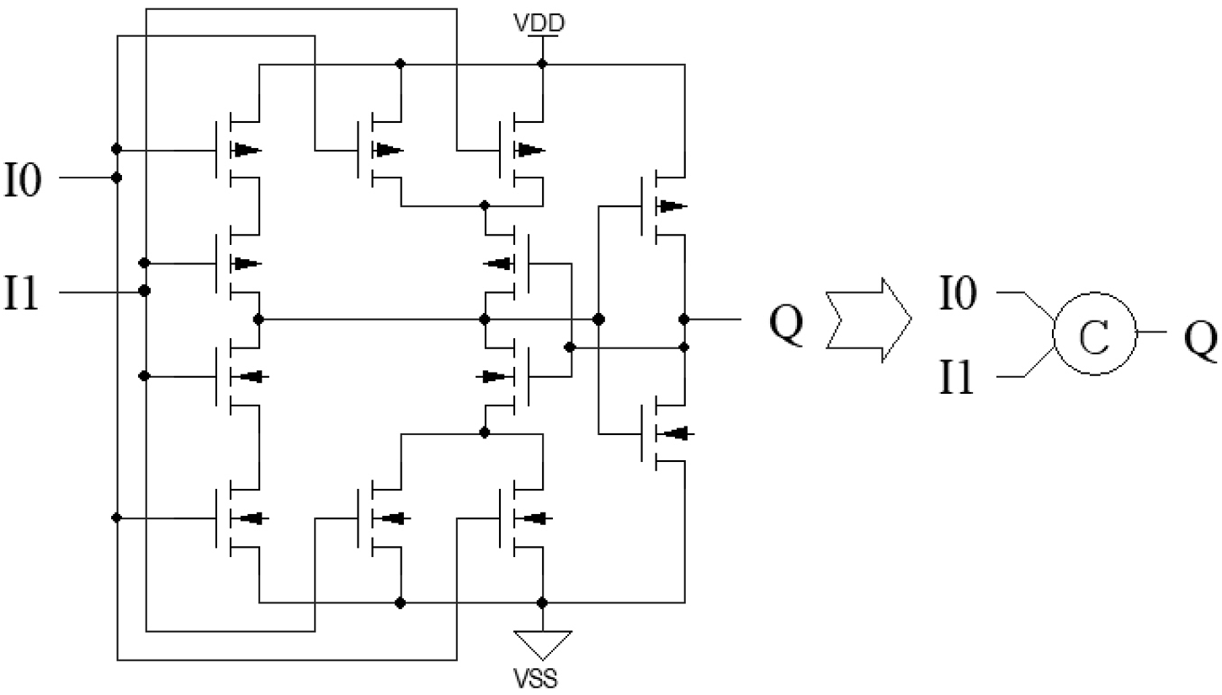
Static two-input C-element
Q⁺ = I₀I₁ + Q(I₀ + I₁)
12 CMOS transistors
EDM2022 8 of 23

Slide 9
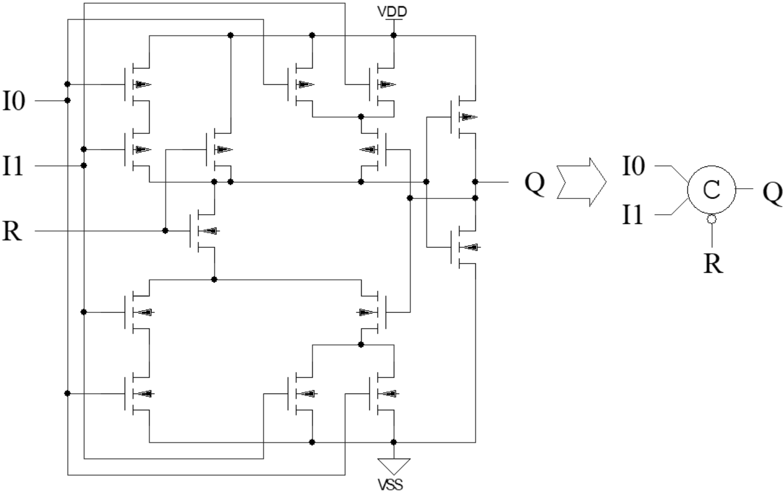
Static C-element with Reset
Q⁺ = R(I₀I₁ + Q(I₀ + I₁))
14 CMOS transistors
EDM2022 9 of 23

Slide 10
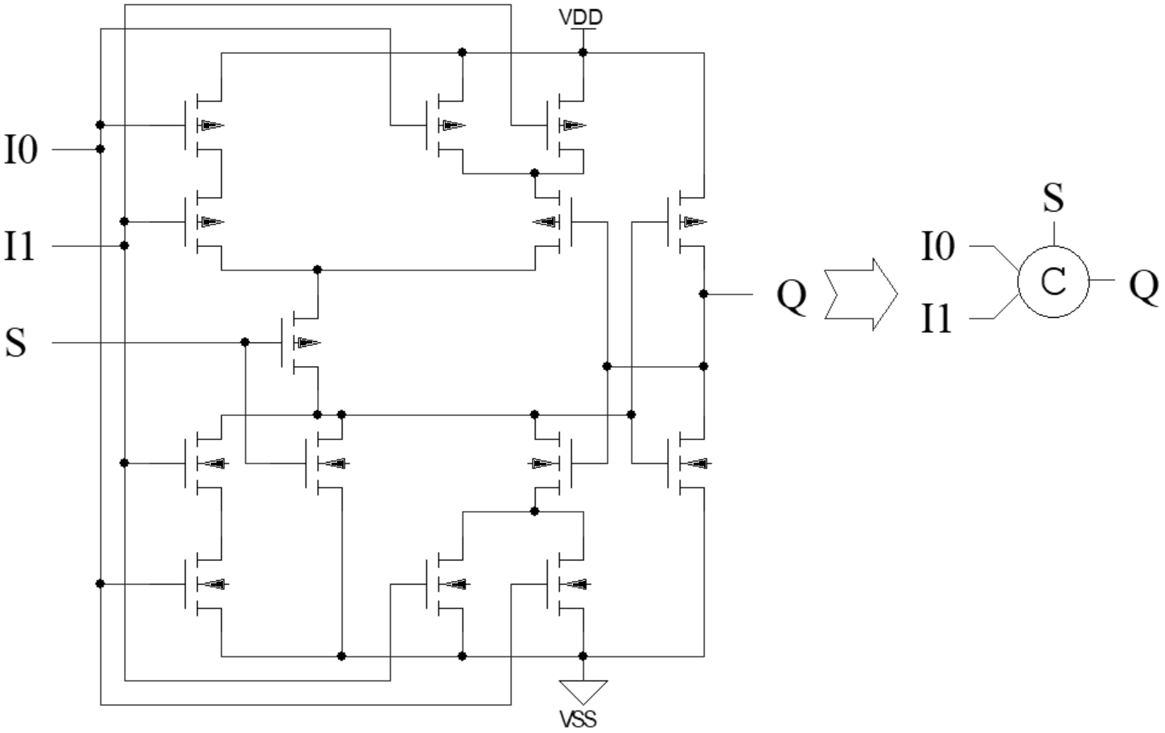
Static C-element with Preset
Q⁺ = I₀I₁ + Q(I₀ + I₁) + S
14 CMOS transistors
EDM2022 10 of 23

Slide 11
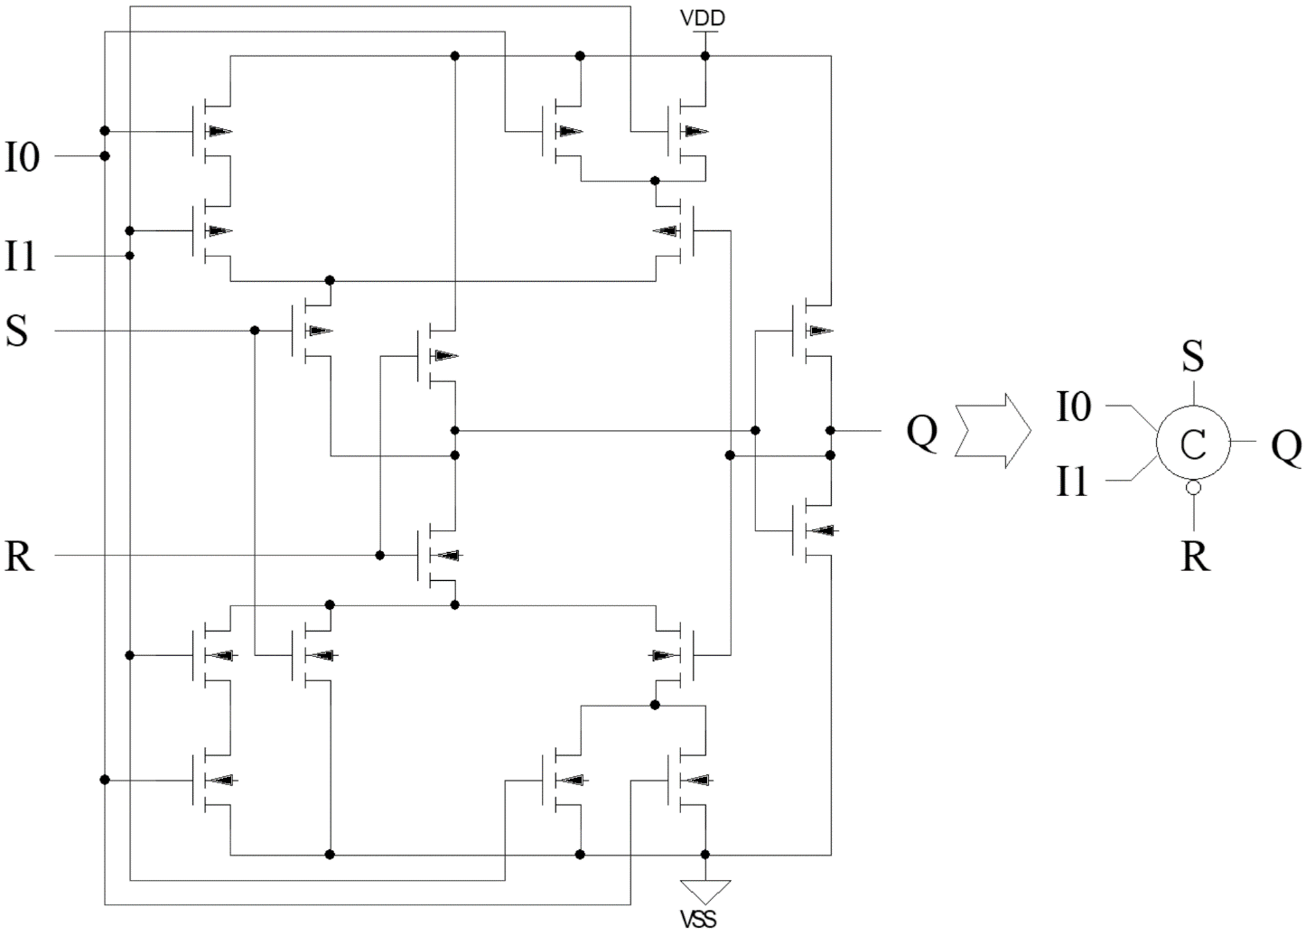
Static C-element with both Reset and Preset
Q⁺ = R(I₀I₁ + Q(I₀ + I₁) + S)
16 CMOS transistors
EDM2022 11 of 23

Slide 12
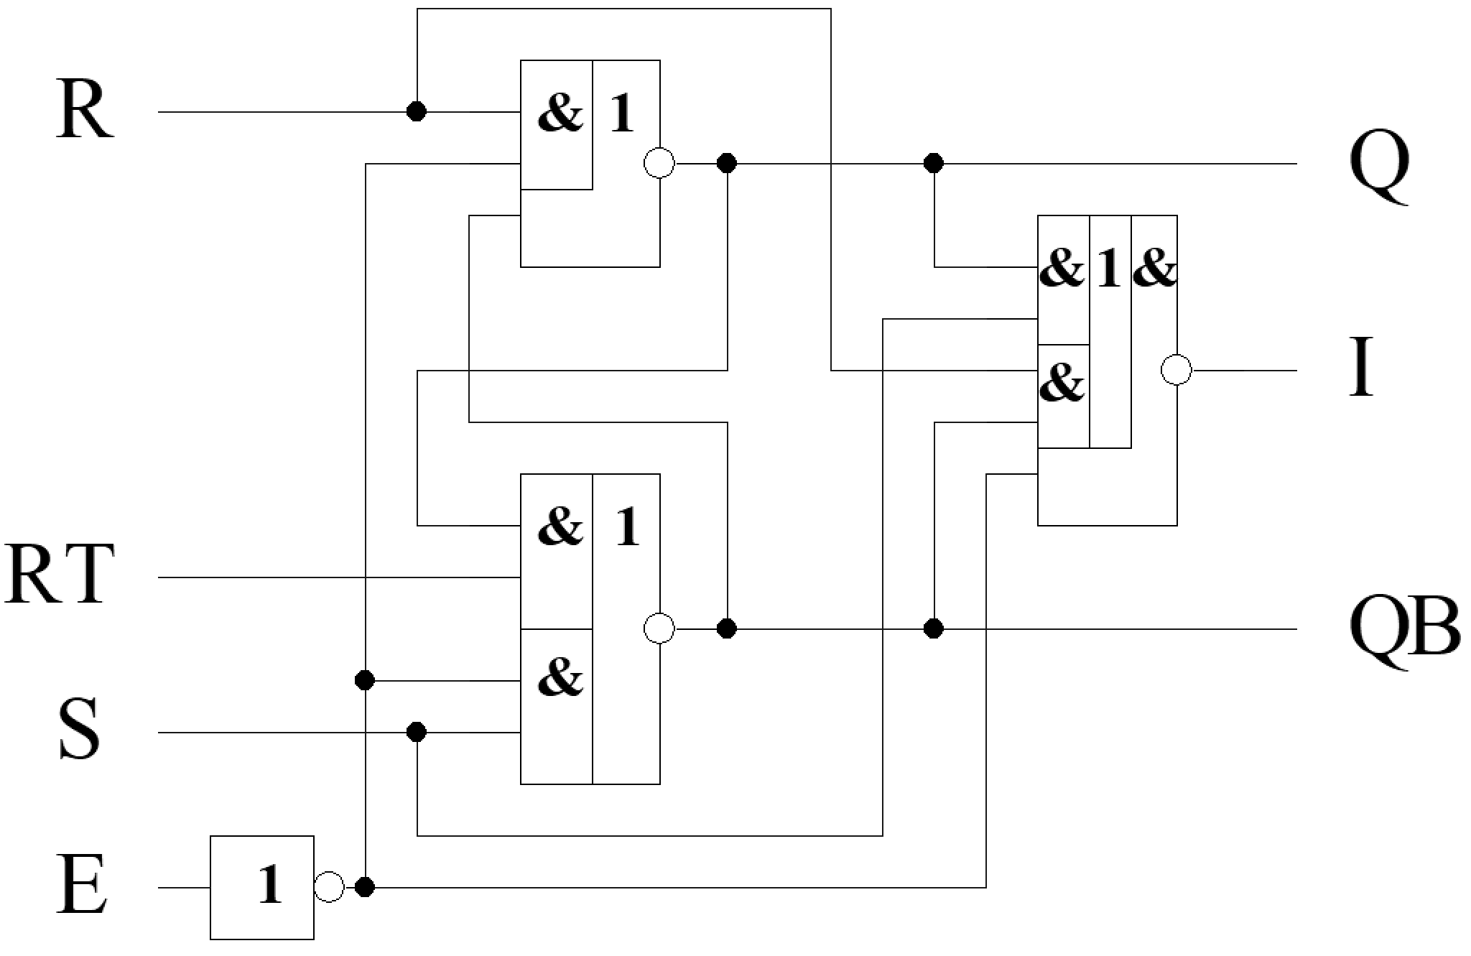
ST Register Bit on RS-latch (1)
26 CMOS transistors
(R, S) and (Q, QB) – the bi-stable information signals,
E – an acknowledgement signal from a subsequent circuit,
RT – an asynchronous reset,
I – an indication output
EDM2022 12 of 23

Slide 13
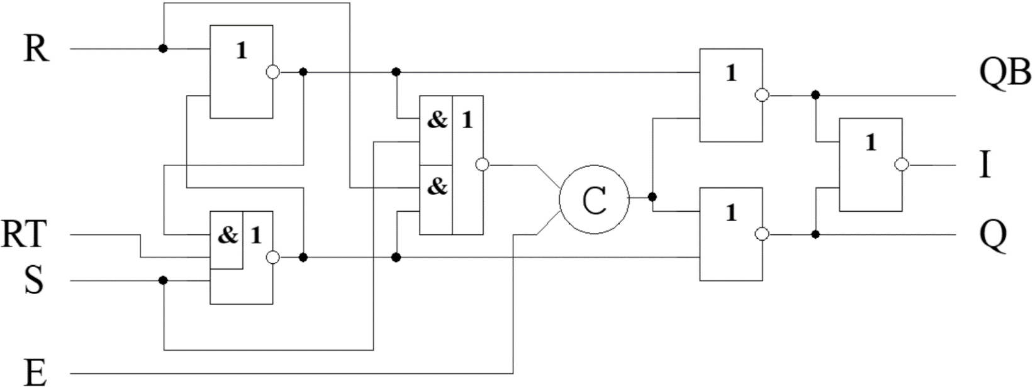
ST Register Bit on RS-latch (2)
42 CMOS transistors
(R, S) and (Q, QB) – the dual-rail information signals with null spacer,
E – an acknowledgement signal from a subsequent circuit,
RT – an asynchronous reset,
I – an indication output
EDM2022 13 of 23

Slide 14
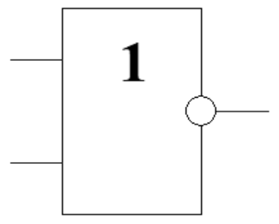
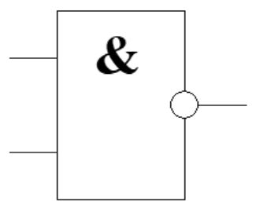
Dual-Rail Coding
Indication
X | XB | State
0 | 0 | Null spacer
0 | 1 | Bit 0
1 | 0 | Bit 1
1 | 1 | Unit spacer
X
XB
I
X
XB
I
Any dual-rail information signal has only one spacer, either null or unit!
EDM2022 14 of 23

Slide 15
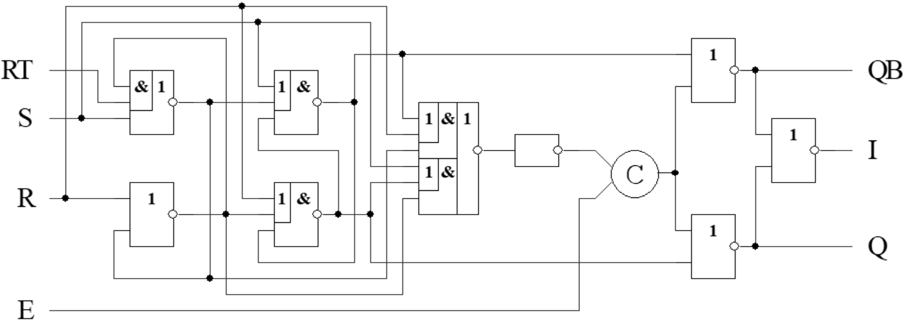
ST Register Bit on RS-flip-flop
60 CMOS transistors
(R, S) and (Q, QB) – the dual-rail information signals with null spacer, E – an acknowledgement signal from a subsequent circuit,
RT – an asynchronous reset,
I – an indication output
EDM2022 15 of 23

Slide 16
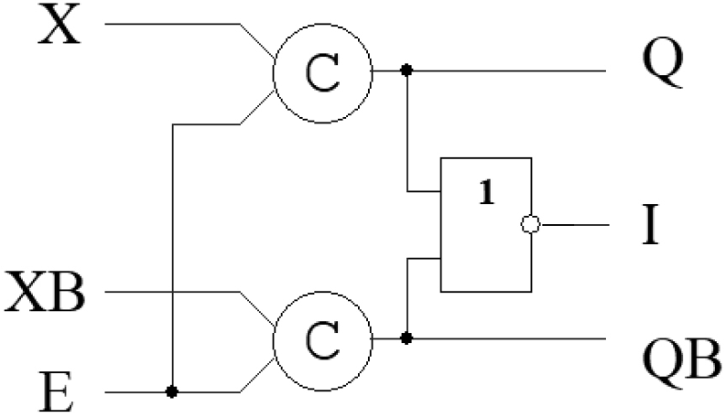
ST Register Bit on C-elements (1)
28 CMOS transistors
1.5 – 2.1 times simpler than other cases !!
(X, XB) and (Q, QB) – the dual-rail information signals with null spacer, E – an acknowledgement signal from a subsequent circuit,
I – an indication output
EDM2022 16 of 23

Slide 17
ST Register Bit on C-elements (2)
X, XB
E (Ack)
Q, QB
I (Req)
Data
Spacer
Data
Spacer
Data
Spacer
cer
Data
Spacer
Data
Spacer
Data
Spa
Request-Acknowledge interaction
EDM2022 17 of 23

Slide 18
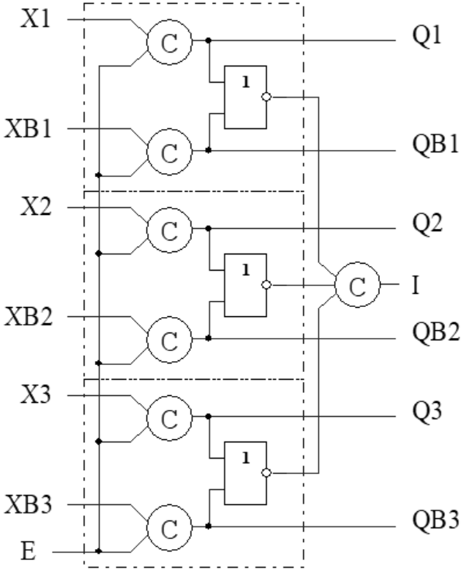
ST Register with no preset
Null spacer
Unit spacer
EDM2022 18 of 23

Slide 19
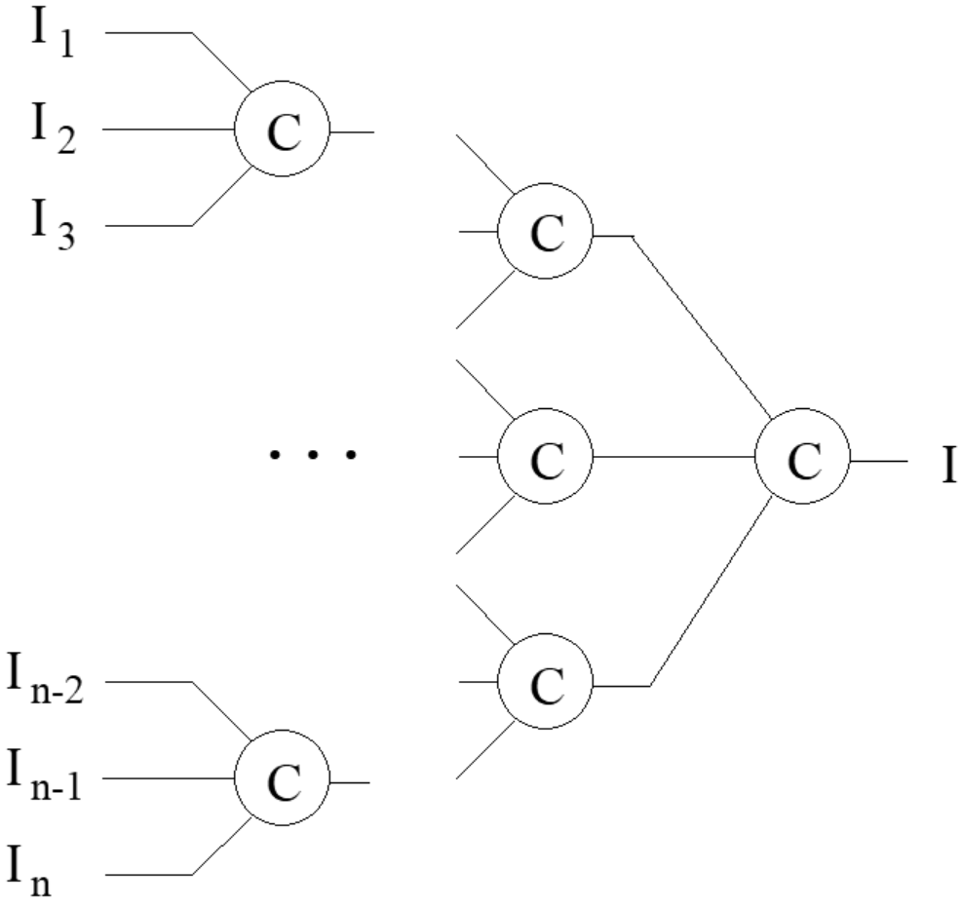
Multi-input Indication subcircuit
EDM2022 19 of 23

Slide 20
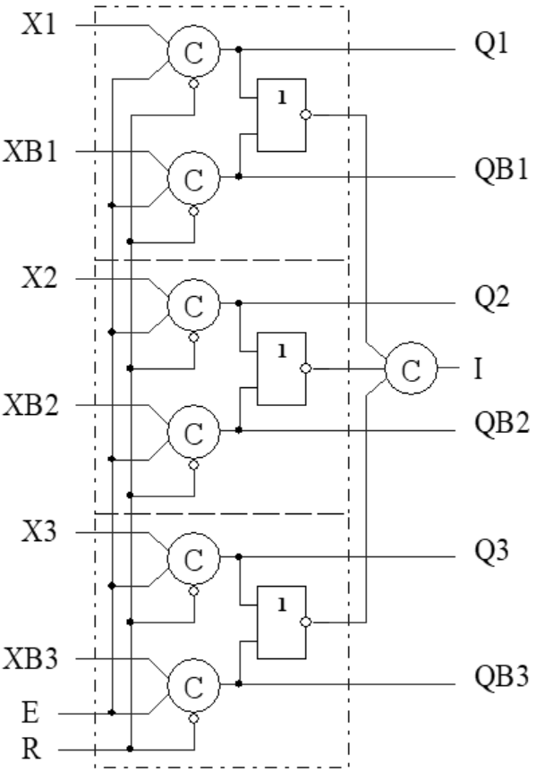
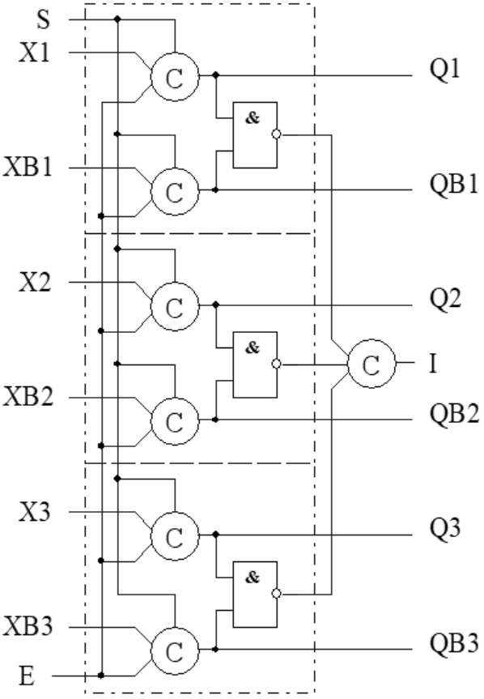
ST Register with Reset to Spacer
Null spacer
Unit spacer
EDM2022 20 of 23

Slide 21
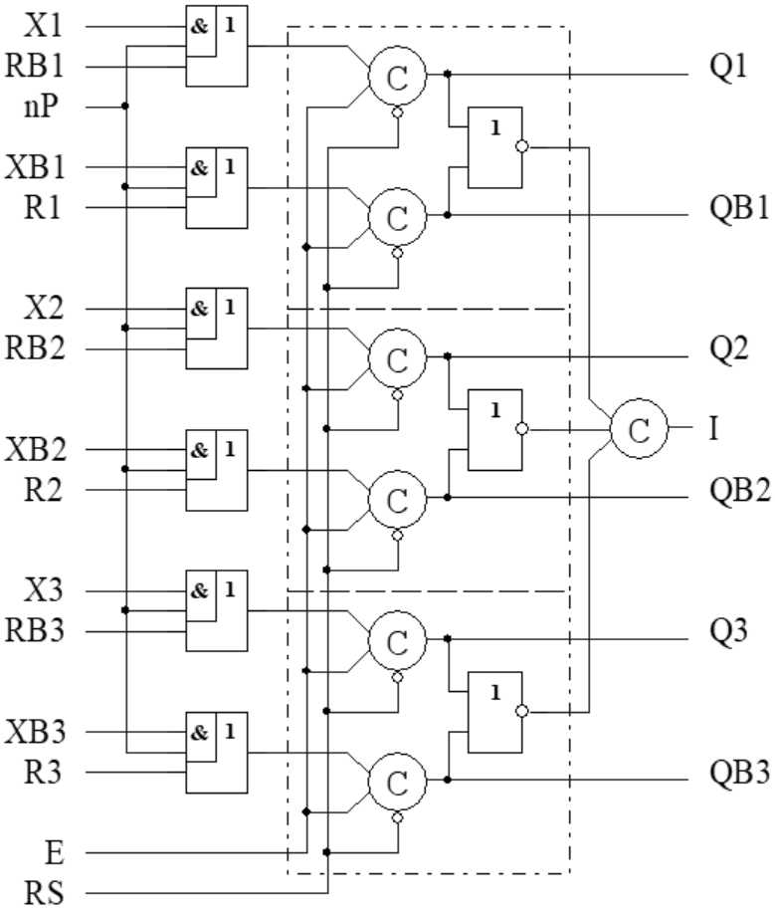
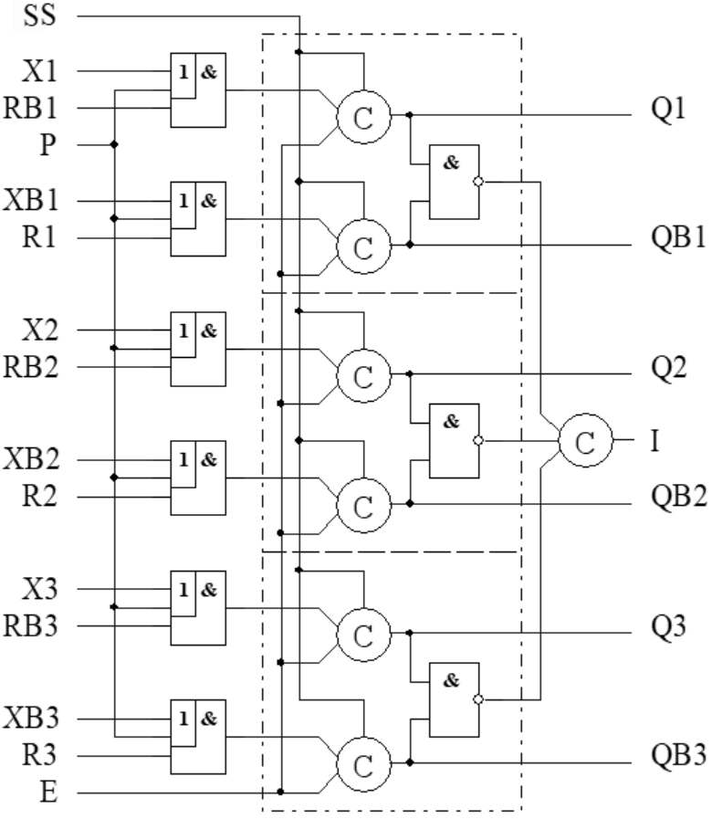
ST Register with Bit-Wise Preset
Null spacer
Unit spacer
EDM2022 21 of 23

Slide 22
Conclusions
Muller’s C-element is the best basis for the self-timed storage register implementation as it decreases register’s complexity in 1.5 through 2.1 times compared to RS-latch and RS-flip-flop counterparts.
The proposed C-element cases on CMOS transistors provide typical self-timed storage register implementations with different options
The self-timed storage register on C-elements provides minimal hardware redundancy at a factor of 1.4 compared to synchronous counterparts while combinational self-timed circuits have the hardware redundancy at a factor of 2.5 through 3
EDM2022 22 of 23

Slide 23
Contacts
Director: Academician Igor Sokolov
Address: Institute of Informatics Problems, Federal Research Center “Computer Science and Control" of the Russian Academy of Sciences,
44 b.2 Vavilova str., Moscow, 119333
Phone: +7 (495) 137 34 94
Fax: +7 (495) 930 45 05
E-mail: isokolov@ipiran.ru
Speaker: Diachenko Yuri, diaura@mail.ru
EDM2022 23 of 23

