Slide 1

Self-Timed Pipeline with Variable Stage Number
I. Sokolov, Y. Stepchenkov, Y. Diachenko,
Y. Rogdestvenski, D. Diachenko, L. Plekhanov
Institute of Informatics Problems,
Federal Research Center
"Computer Science and Control" of the
Russian Academy of Sciences

Slide 2
Outline
Self-timed circuits vs Synchronous ones
Synchronous and self-timed pipelines
Bypassing pipeline stages
Self-timed pipeline bypass technique
Conclusions
EIConRus2023 2 of 20

Slide 3
Self-Timed Circuits
They are free of global synchronization and operate based on a request-acknowledge interaction between circuit parts.
Major principles:
two-phase work discipline,
Mandatory acknowledging completion of all switches initiated during the transition to the current phase of work
EIConRus2023 3 of 20

Slide 4
Self-Timed Circuit’s Advantages
Absence of a global clock tree accounting for up to 30% of total power consumption
Absence of glitches and hazards
Correct operation under any operating conditions
High performance determined by the actual cells' delays in the current operating conditions, not the worst case
EIConRus2023 4 of 20

Slide 5
Simple Synchronous Pipeline
Stages S2 and S3 are the slowest
S₂
S₃
S₁
S_{N−1}
S_{N}
DataIn
…
DataOut
Clock
Pipeline’s delay (latency) = N∙T_{clock}
Output result’s periodicity = T_{clock}
T_{clock} – Global clock period for worst conditions
EIConRus2023 5 of 20

Slide 6
Synchronous Pipeline with Bypass
Control
S₁
S_{N}
DataIn
S₂
MX
DataOut
S_{N−1}
…
Clock
Pipeline’s average delay = (P_{BP}∙2+P_{Full}∙N)∙T_{clock} , where P_{BP} and P_{Full} are path probabilities (P_{BP} + P_{Full} = 1)
Output result’s periodicity = T_{clock}
EIConRus2023 6 of 20

Slide 7
Simple Self-Timed (ST) Pipeline
Stages S2 and S3 are the slowest
S₂
R A
S₃
R A
S₁
R A
S_{N−1}
R A
S_{N}
R A
DataIn
…
DataOut
Ack
…
Req
Pipeline’s delay = N∙T_{phase2}
Output result’s periodicity = 4∙T_{phase2}
T_{phase2} – actual S₂ stage’s switch-to-phase duration
EIConRus2023 7 of 20

Slide 8
ST Pipeline’s Phase Diagram
Previous and subsequent stages affect the current stage’s phase switching
1 | S | W |  | S |  | W |  | S |  | W |  | S |  | W |  | S
2 | S |  | W |  | S |  | W |  | S |  | W |  | S |  | W |  | S
3 | S |  |  | W |  | S |  | W |  | S |  | W |  | S |  | W |  | S
4 | S |  |  |  | W |  | S |  | W |  | S |  | W |  | S |  | W |  | S
5 | S |  |  |  |  | W |  | S |  | W |  | S |  | W |  | S |  | W
6 | S |  |  |  |  |  | W |  | S |  | W |  | S |  | W |  | S |  | W
“S” – spacer phase;
“W” – working phase;
others – waiting
Output period = 4T_{phase2}
Latency = 6T_{phase2}
EIConRus2023 8 of 20

Slide 9
ST Pipeline Stage
CP
Ind
Rg
E Ind
DataIn
DataOut
Register indicates all CP’s information outputs
E
C
C
A
R
CP– combinational part;
Rg – output register;
C – Muller’s C-element
A – acknowledge output;
E – register’s control signal;
R – request input
EIConRus2023 9 of 20

Slide 10
ST Pipeline Stage’s Register Bit
Null spacer
Unit spacer
X
C
X
C
Y
Y
1
&
E
Ind
E
Ind
C
C
XB
YB
XB
YB
(X, XB) – dual-rail information input,
(Y, YB) – dual-rail information output,
E – phase-enable signal,
Ind – indication output
EIConRus2023 10 of 20

Slide 11
One ST Pipeline Stage Bypass
MX
S₁
R A
S₃
R A
DataIn
And
S₂
R A
E
DataOut
Ack
Req
BPC
_{L A3}
_{E2}
_{A1 U}
_{R1 A2}
And – multi-bit logical “AND” function;
MX – multi-bit multiplexer;
BPC – bypass control unit
EIConRus2023 11 of 20

Slide 12
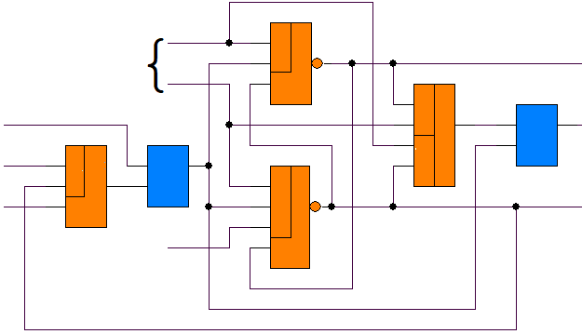
Bypass Control Unit
Self-timed RS-latch
& 1
L
UB
& 1
A1
C
R1
A3
&
1 &
C
& 1
U
A2
E2
L – dual-rail pipeline bypass mode signal;
A1, A2, A3 – acknowledge outputs of the stages;
E2 – stage S₂ register’s control signal;
R1 – S₁ stage’s request input;
U, UB – dual-rail bypass marker
EIConRus2023 12 of 20

Slide 13
ST Pipeline’s Phase Diagram
Every second input data bypasses the slowest stage S₂
1 | S | W |  | S |  | W |  |  | S |  | W |  | S |  | W |  | S
2 | S |  | W |  | S |  |  |  |  |  |  | W |  | S
3 | S |  |  | W |  | S |  | W |  | S |  |  | W |  | S |  | W |  | S
4 | S |  |  |  | W |  | S |  | W |  | S |  |  | W |  | S |  | W |  | S
5 | S |  |  |  |  | W |  | S |  | W |  | S |  |  | W |  | S |  | W
6 | S |  |  |  |  |  | W |  | S |  | W |  | S |  |  | W |  | S |  | W
Output periodicity and Latency become less!
Average output period = 3T_{phase,S2}+1.5T_{phase,S1}
Average latency = 3.5T_{phase,S2}+2.5T_{phase,S1}
EIConRus2023 13 of 20

Slide 14
Two ST Pipeline Stages Bypass
MX
S₁
R A
S₄
R A
DataIn
And
S₂
R A
E
S₃
R A
E
DataOut
Ack
Req
BPC
_{L A4}
_{A2}
_{A1 E2}
_{E3}
_{R1 U}
And – multi-bit logical “AND” function;
MX – multi-bit multiplexer;
BPC – bypass control unit
EIConRus2023 14 of 20

Slide 15
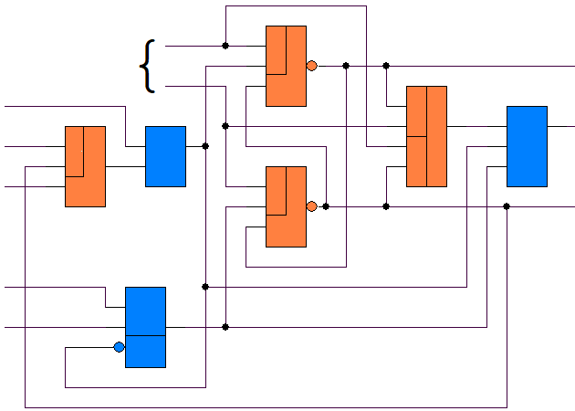
Two-Stage Bypass Control Unit
Self-timed RS-latch
L
& 1
UB
A1
& 1
R1
A4
1 &
C
&
C
A2
& 1
U
E2
C
E3
R
L – dual-rail pipeline bypass mode signal;
A1, A2, A4 – acknowledge outputs of the stages;
E2, E3 – stage register’s control signals;
R1 – S₁ stage’s request input;
U, UB – dual-rail bypass marker
EIConRus2023 15 of 20

Slide 16
ST Pipeline’s Phase Diagram
Every second input data bypasses the slowest stages S₂ and S₃
1 | S | W |  | S |  | W |  |  |  | S |  | W |  | S |  | W |  |  |  | S |  | W
2 | S |  | W |  | S |  |  |  |  |  |  |  | W |  | S
3 | S |  |  | W |  | S |  |  |  |  |  |  |  | W |  | S
4 | S |  |  |  | W |  | S |  | W |  | S |  |  |  | W |  | S |  | W |  | S
5 | S |  |  |  |  | W |  | S |  | W |  | S |  |  |  | W |  | S |  | W |  | S
6 | S |  |  |  |  |  | W |  | S |  | W |  | S |  |  |  | W |  | S |  | W
Output periodicity and Latency become less!
Average output period = 2T_{phase,S2}+3T_{phase,S1}
Average latency = 2.5T_{phase,S2}+3.5T_{phase,S1}
EIConRus2023 16 of 20

Slide 17
ST Pipeline’s Performance
Pipeline performance comparison for the cases:
A - typical 6-stage pipeline with the slowest stages S₂ and S₃;
B - the same pipeline with regular bypassing stage S₂;
C - the same pipeline with regular bypassing stages S₂ and S₃,
in the following assumptions:
T_{phase,S1} = T_{phase,S4} = T_{phase,S5} = T_{phase,S6} = kT₀, k < 1,
T_{phase,S2} = T_{phase,S3} = T₀,
Bypass occurs every second input data portion.
Case | A | B | C
Average output periodicity | 4T₀ | (3 + 1.5k)T₀ | (2 + 3k)T₀
Average latency | 6T₀ | (3.5 + 2.5k)T₀ | (2.5 + 3.5k)T₀
EIConRus2023 17 of 20

Slide 18
ST Pipeline’s Performance
Average output periodicity, T₀
Average latency, T₀
k
k
A - typical 6-stage pipeline with the slowest stages S₂ and S₃;
B - the same pipeline with regular (each second sample) bypassing stage S₂;
C - the same pipeline with regular bypassing stages S₂ and S₃,
EIConRus2023 18 of 20

Slide 19
Conclusions
ST circuit pipeline organization increases its performance, similarly to synchronous circuits.
The optional bypass of one or more stages under some conditions ensures the average pipeline’s performance increase if the bypassed stages are sufficiently slowest among all pipeline stages.
The slower the stages being bypassed compared to the other stages, the lower the average output periodicity and latency of the self-timed pipeline.
ElConRus2023 19 of 20

Slide 20
Contacts
  Director: Academician Igor Sokolov
  Address: Institute of Informatics Problems, Federal Research Center “Computer Science and Control" of the Russian Academy of Sciences,
  44 b.2 Vavilova str., Moscow, 119333
Phone: +7 (495) 137 34 94
Fax: +7 (495) 930 45 05
E-mail: isokolov@ipiran.ru
Speaker: Diachenko Yury diaura@mail.ru
ElConRus2023 20 of 20

