Slide 1

Self-Timed pipeline protection against critical fault
Y. Stepchenkov, Y. Diachenko, G. Appolonov, N. Morozov, D. Stepchenkov, D. Diachenko
Institute of Informatics Problems, Federal Research Center
"Computer Science and Control" of the Russian Academy of Sciences

Slide 2
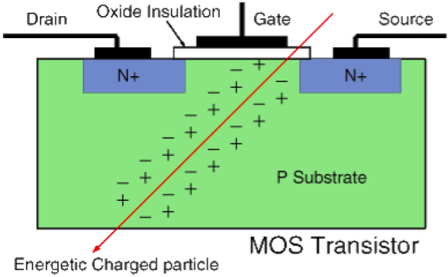
Fault Types
Faults
Soft errors
Self-disappeared
Critical
Failures
VDD
A
B
VSS
Ionization current:
Cosmic rays
Nuclear particles
Radiation
Noises:
Cross-talk
Power bus noise
Substrate noise
ElConRus2025 2 of 18

Slide 3
Self-Timed Circuit Redundancy
Synchronous circuit
Self-timed circuit
F
F
N Unary Inputs
Output
Output
2N Dual-rail Inputs
Ind
Indicator
F
Inversed Output
Combinational self-timed circuits utilize the dual-rail data coding
EIConRus2025 3 of 18

Slide 4
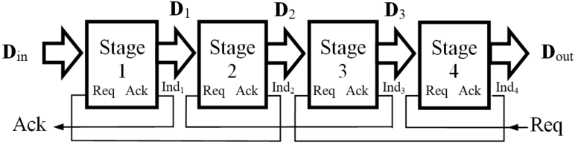
Self-Timed Pipeline
Ack – Acknowledgement output;
Req – Request input
The ST pipeline interaction principle:
any pipeline stage can switch to the working (spacer) phase only after the subsequent stage has completed switching to the spacer (working) phase, and the information outputs of the preceding stage have switched to the working (spacer) phase
EIConRus2025 4 of 18

Slide 5
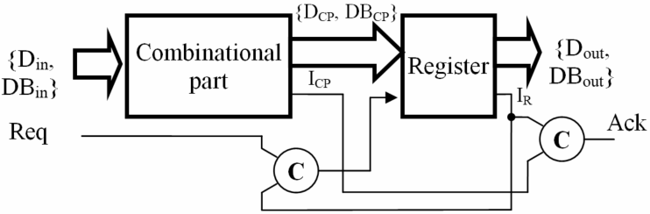
Self-Timed Pipeline Stage
Req –Request input
Ack –Acknowledge output
Dual-Rail Coding with Null and Unit Spacer
NN | X | XB | State
 |  |  | Null Spacer | Unit Spacer
1. | 0 | 0 | Spacer | Antispacer
2. | 0 | 1 | Bit 0 | Bit 0
3. | 1 | 0 | Bit 1 | Bit 1
4. | 1 | 1 | Antispacer | Spacer
EIConRus2025 5 of 18

Slide 6
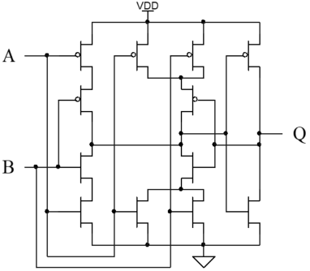
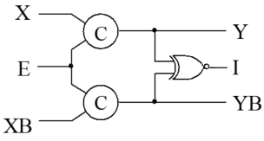
Muller’s C-element
C-element
Q⁺ = AB + Q(A + B)
Register bit
(X, XB) and (Y, YB) – dual-rail signals with the same spacer;
E – phase input;
I – indication output
EIConRus2025 6 of 18

Slide 7
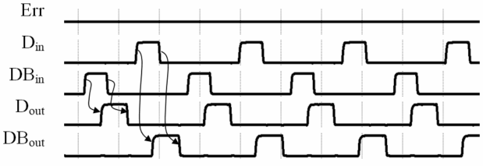
Self-Timed Pipeline Operation Diagram without Soft Errors
E – soft error signal;
(D_{in},DB_{in}) – dual-rail input;
(D_{out},DB_{out}) – dual-rail output;
EIConRus2025 7 of 18

Slide 8
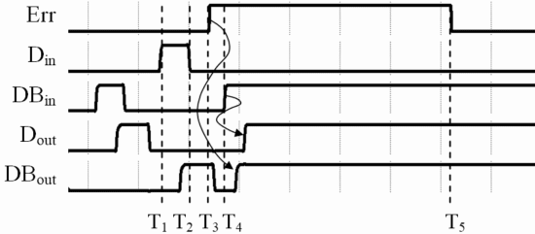
ST Pipeline Operation Diagram with Antispacer
Soft error at T₃ leads to an antispacer state when a working phase starts (at T₄). Then antispacer gets a register bit, propagates to the pipeline output (D_{out},DB_{out}) and stops the pipeline operation
EIConRus2025 8 of 18

Slide 9
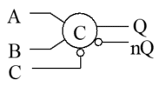
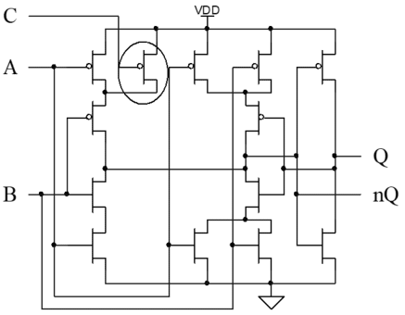
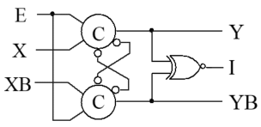
Modified Muller’s C-element
Modified C-element circuit
Symbol view
Register bit
EIConRus2025 9 of 18

Slide 10
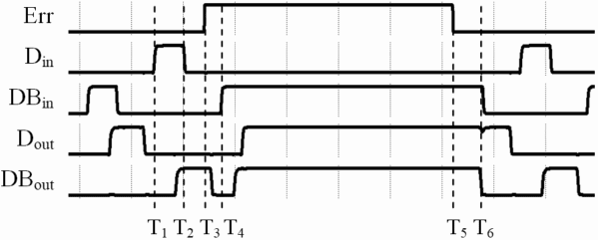
ST Pipeline Diagram with Modified C-element and SE at Spacer Phase
Soft error at T₃ leads to an antispacer state when a working phase starts (at T₄). However, the pipeline continue to operate when soft error ends.
EIConRus2025 10 of 18

Slide 11
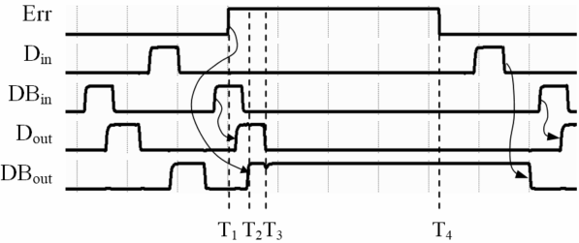
ST Pipeline Diagram with Modified C-element and SE at Working Phase
Soft error at the working phase (at T₁) leads to an incorrect working state starts (at T₃). Modified C-element does not repair it after soft error ends.
EIConRus2025 11 of 18

Slide 12
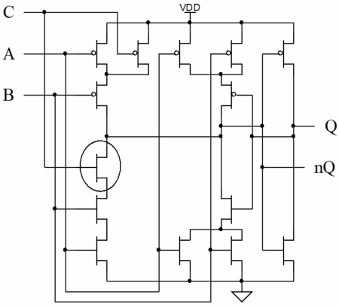
Improved Muller’s C-element
Additional transistor prevents the anti-spacer writing into register bit.
EIConRus2025 12 of 18

Slide 13
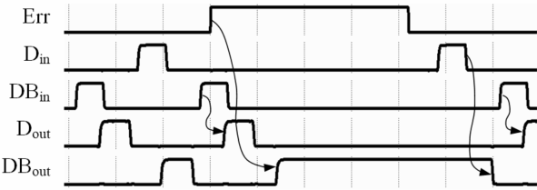
ST Pipeline Diagram with Improved C-element and SE at Working Phase
Register bit affected by the soft error does not switch to the anti-spacer and remains in the correct working state that prevents output data corruption.
EIConRus2025 13 of 18

Slide 14
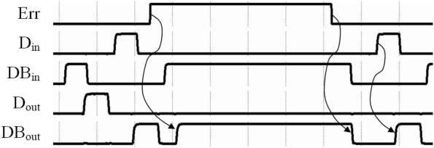
ST Pipeline Diagram with Improved C-element and SE at Spacer Phase
Soft error at the spacer phase corrupts the pipeline’s output data.
EIConRus2025 14 of 18

Slide 15
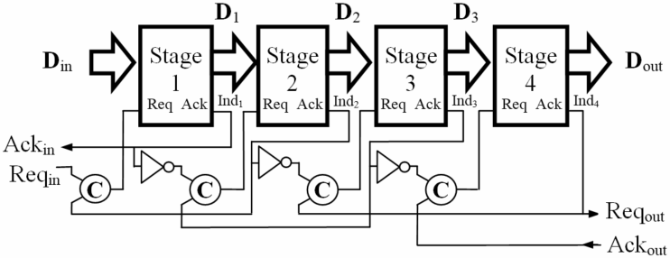
ST Pipeline with Improved Protection against Soft Errors
Indication output of each pipeline stage delays the subsequent stage's request input switch, thus increasing soft error masking propability.
EIConRus2025 15 of 18

Slide 16
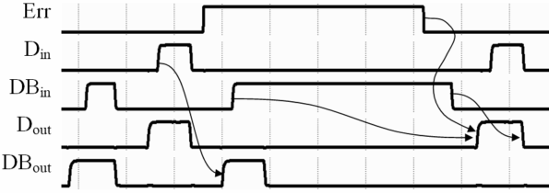
Improved ST Pipeline Diagram with Soft Error at Spacer Phase
Soft error appeared at the spacer phase does not corrupt output data, and only increases working phase’s duration.
EIConRus2025 16 of 18

Slide 17
Conclusions
Due to the two-phase discipline and redundant coding of information signals, the self-timed pipeline successfully masks a significant part of the soft errors.
Using the advanced Muller's C-element as a storage cell in the self-timed pipeline stage register bit increases pipeline’s fault tolerance level and prevents the pipeline's stall.
The forced delay of the stage register's write enable signal using the preceding stage's indication output masks the soft error at the spacer phase. The penalty for obtained fault tolerance increase is 19% decrease in the pipeline's performance.
ElConRus2025 17 of 18

Slide 18
Thanks for Your Attention !
ElConRus2025 18 of 18

